Slide 1
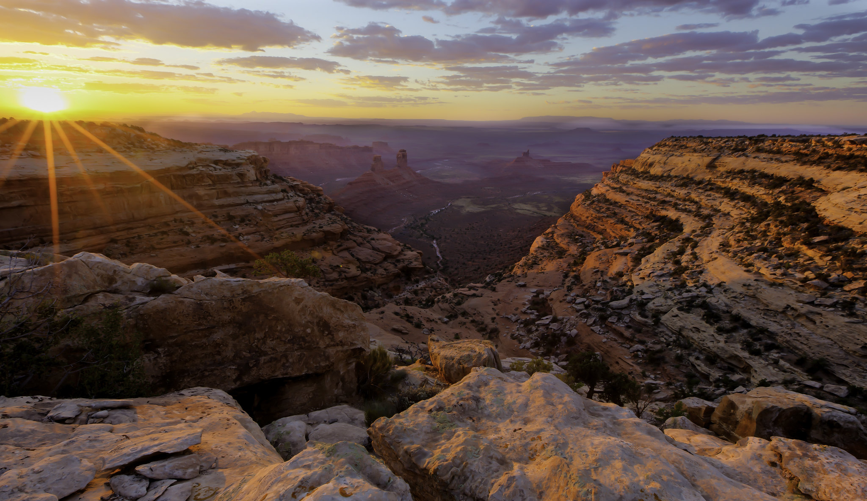

Hope in Hard Times: Successful Legal Advocacy in the Trump Era
Todd Tucci, Lizzy Potter, Sarah Stellberg
Advocates for the West
Boise / Portland
CLF Rendezvous, September 14, 2019

Slide 2
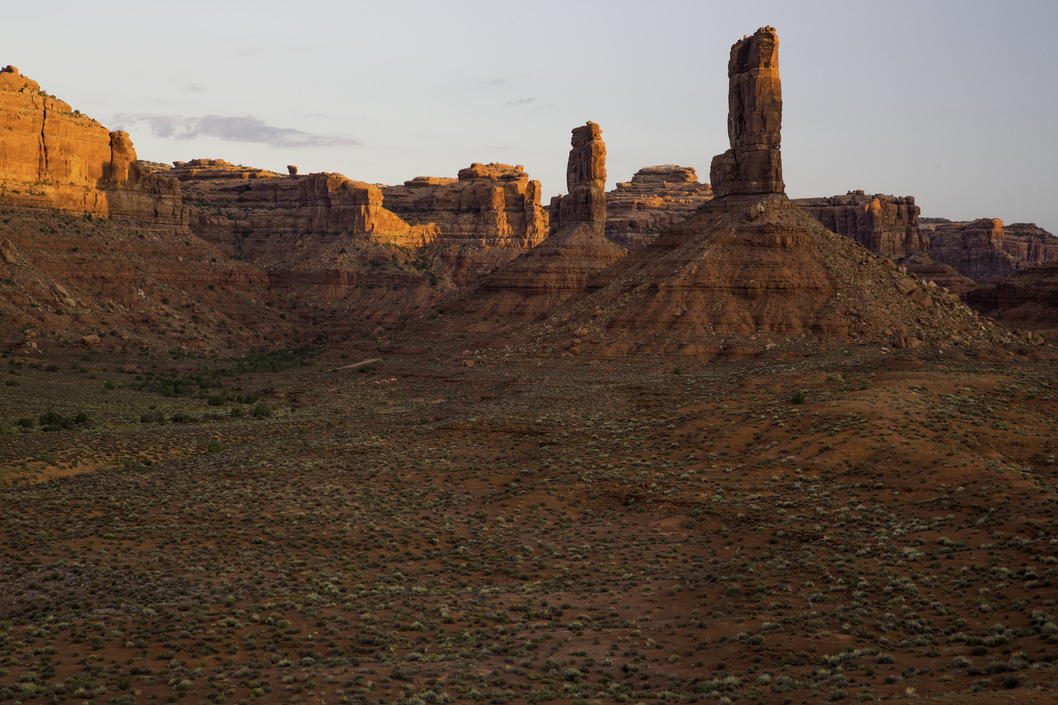
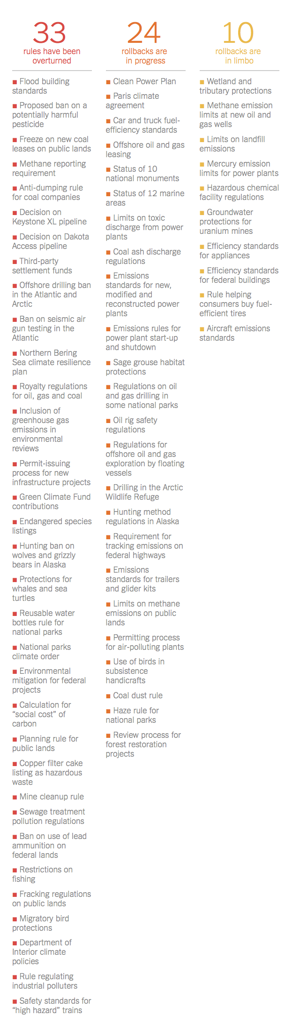
TRUMP ROLLBACKS – Rendezvous 2018

Slide 3
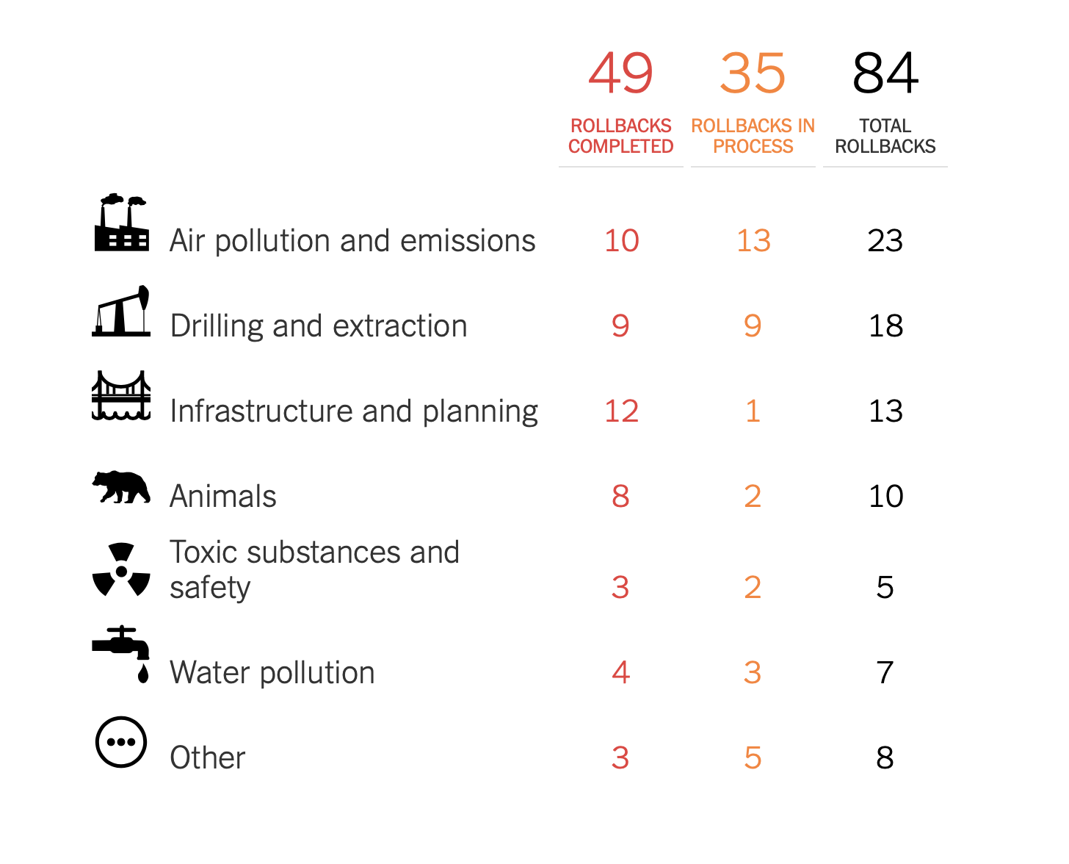
Trump Rollbacks Now

Slide 4
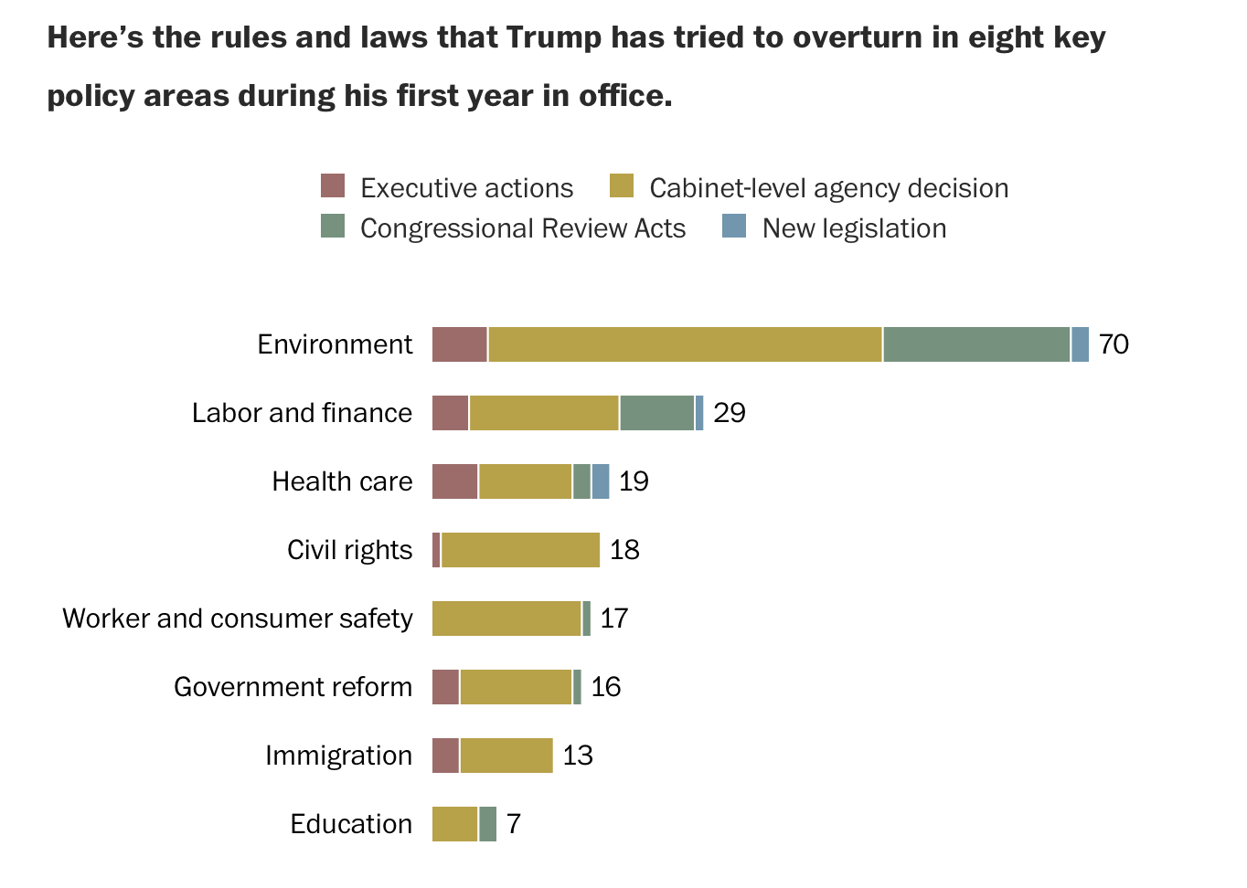
Trump Rollbacks Now

Slide 5
TRUMP ROLLBACKS
Rescinded water pollution regulations for fracking
WOTUS
Rescinded rule limiting seismic exploration in Atlantic
Arctic National Wildlife Refuge
Eliminated Protections for Greater Sage Grouse across the West
Undermining Wildlife Protections
Weakening Management Plans
Shrinking National Monuments
Promoting Fossil Fuel Development
Short-Circuiting NEPA
Excluding the Public

Slide 6
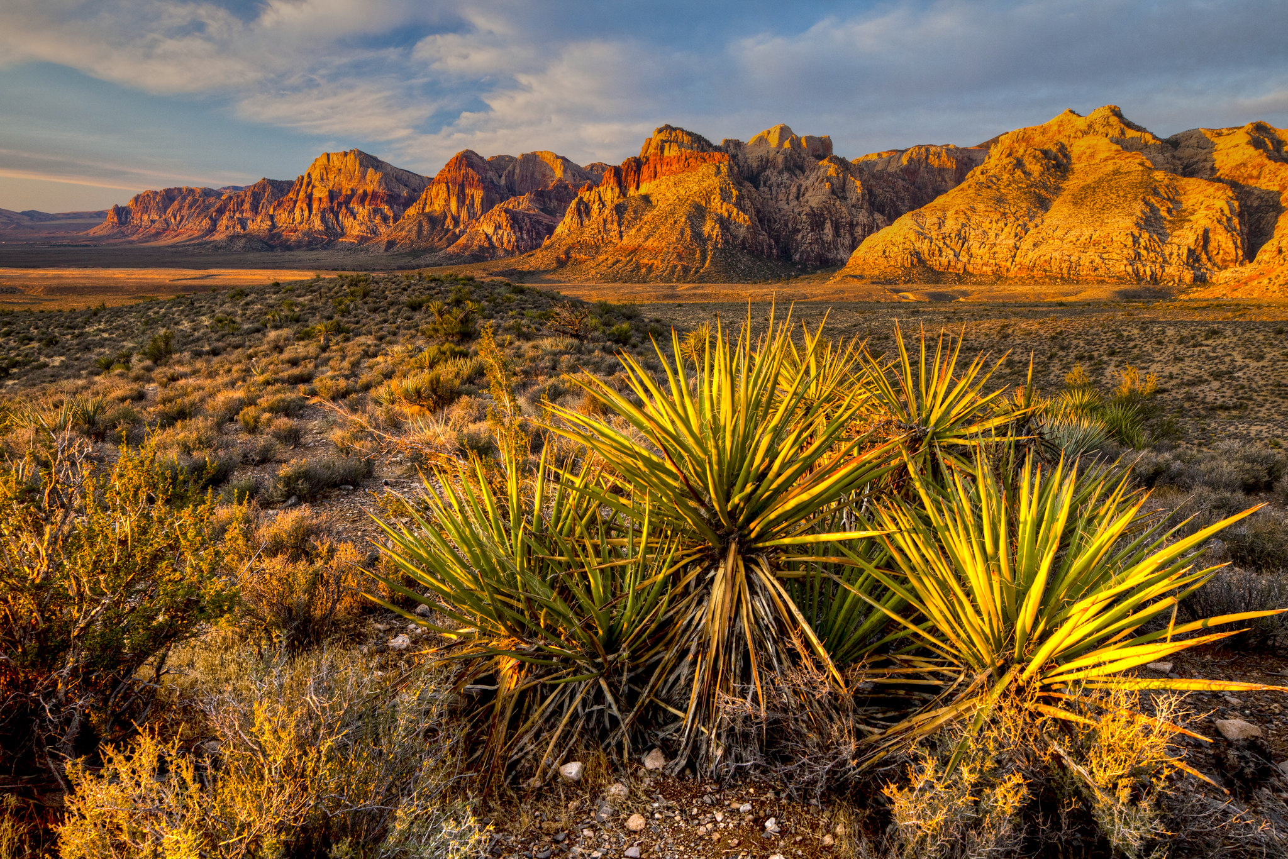
The Law is the Last Bastion of
Opposition to Executive Decisions

Slide 7
What IS ADVOCACY
Advocacy – An activity by an individual or group which aims to influence decisions within the political, economic, and social systems and institutions
Legislative Advocacy
Administrative Advocacy
Grassroots Advocacy
Legal Advocacy

Slide 8
What IS LEGAL ADVOCACY
Legal Advocacy – Using state and federal legal tools, processes and procedures to influence agency decisions Public Engagement in Agency Decisions Engagement in the Administrative Process Federal Court Litigation

Slide 9
LEGAL ADVOCACY IS A TOOL
Pick Your Battles
Find Your Friends
Divide and Conquer
Engage the Process

Slide 10
TRUMP ROLLBACKS
Rescinded water pollution regulations for fracking
WOTUS
Rescinded rule limiting seismic exploration in Atlantic
Arctic National Wildlife Refuge
Eliminated Protections for Greater Sage Grouse across the West
Undermining Wildlife Protections
Weakening Management Plans
Shrinking National Monuments
Promoting Fossil Fuel Development
Short-Circuiting NEPA
Excluding the Public

Slide 11
Undermining Wildlife Protections
ESA regulations
ESA listing decisions
Localized implementation decisions – ESA § 7
11

Slide 12
Undermining Wildlife Protections
ESA Regulations
Final Rule issued in August 2019
Allows consideration of economics in listing decisions
Eliminates blanket 4(d) rule for Threatened species
Making designation of Critical Habitat more difficult, especially unoccupied habitat
PICK YOUR BATTLES
12

Slide 13
Undermining Wildlife Protections
ESA Listing Decisions
FWS required to issue series of listing decisions via settlement and court order dating back to Obama Administration
5-year work plan - parties never anticipated Trump and Bernhardt issuing these decisions
Grizzlies, bison, wolves, caribou, sagebrush lizard, etc...
Other listing decisions coming
PICK YOUR BATTLES
13

Slide 14
Undermining Wildlife Protections
Local Implementation Decisions - § 7
Localized (systematic) effort to undermine existing protections across local landscapes – our backyards
Localized litigation and opposition – e.g. Red Cliffs NCA
Find your friends and allies
Divide and conquer
Engage in the process
Implications
Death by 1000 cuts
Requires local capacity and engagement
14

Slide 15
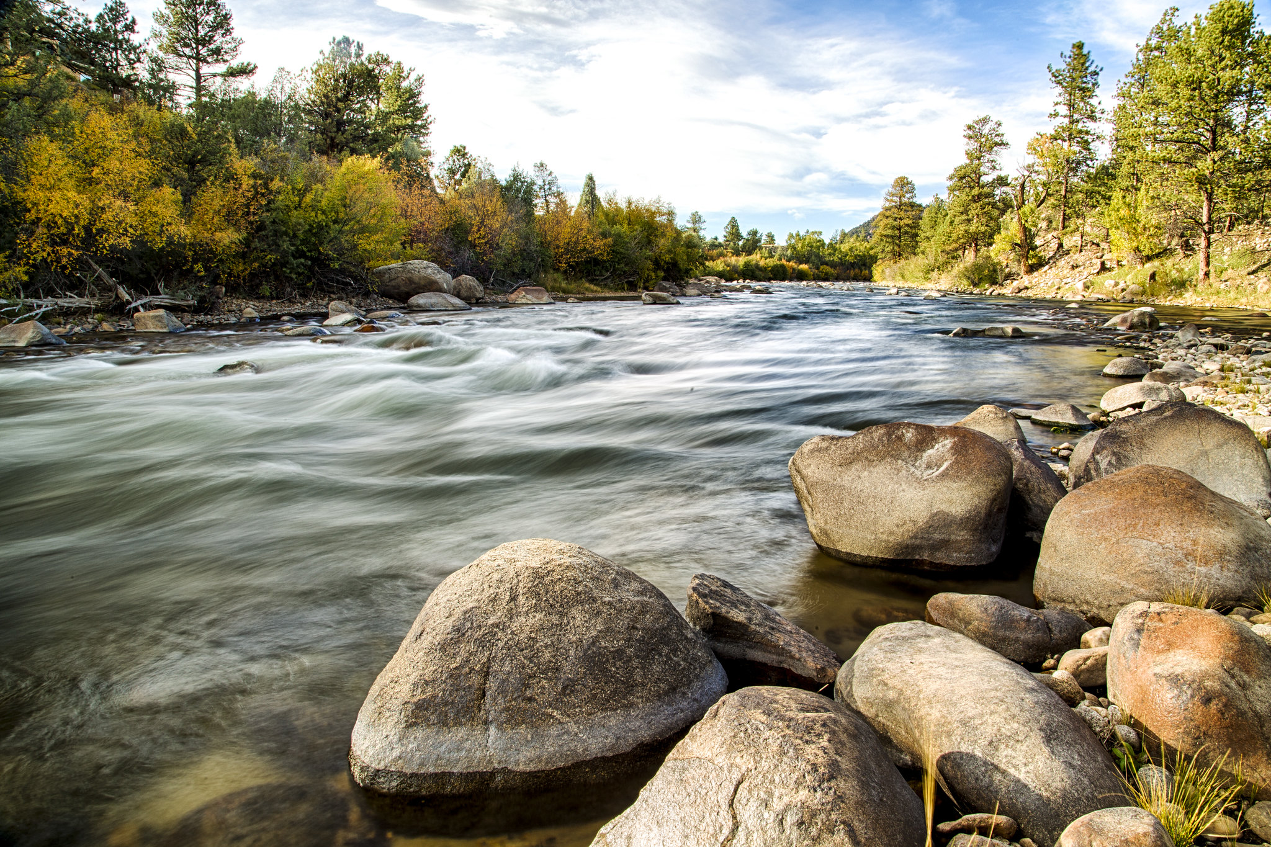
Weakening Management Plans
RMPs establish appropriate management of federal public lands for a generation
Roads, ORVs, Mineral leasing and exploration, Grazing, Vegetation treatments
DOI/BLM slow out of the gate – picking up steam
Uncompahgre
San Pedro Riparian NCA
GSE NM
BE NM
Greater Sage Grouse RMPs
15

Slide 16
Weakening Management Plans
ENGAGE THE PROCESS
PUBLIC COMMENT SCOPING
⬇
DEVELOP DRAFT RMP/EIS
⬇
DRAFT RMP/PUBLIC COMMENT PERIOD
⬇
PROPOSED RMP/FINAL EIS REVIEW
⬇
PROTEST
⬇
ISSUE ROD and APPROVED RMP
16

Slide 17
Shrinking National Monuments
Bears Ears NM and Grand Staircase Escalante NM
Pick Your Battles
Find Your Friends
Divide and Conquer
Engage the Process
It is Not Over – Zinke Report
Gold Butte
Cascade-Siskiyou
Organ Mountains Desert Peaks
Rio Grande Del Norte
Pacific Remote Islands and Rose Atoll
Northeast Canyons and Seamounts
Katahdin Woods and Waters
5 Marine and 22 NM under Review

Slide 18
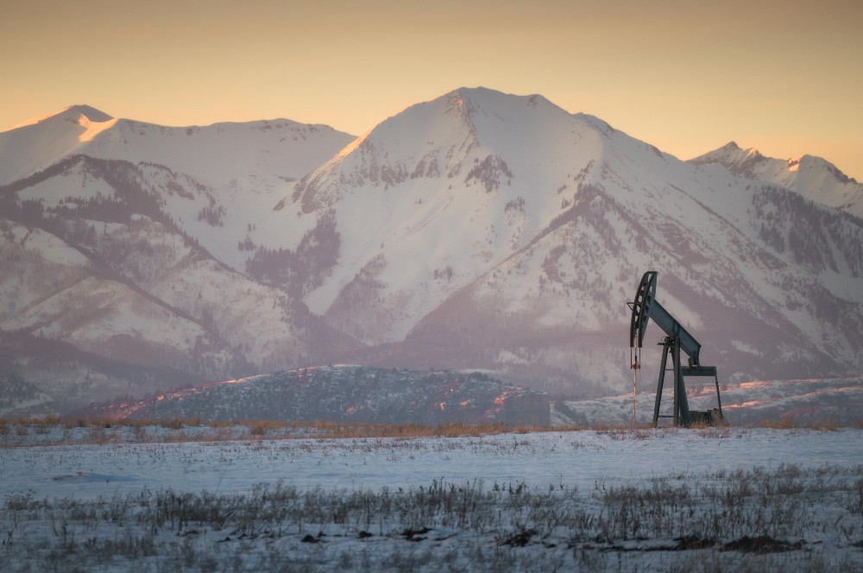
Promoting Fossil Fuel Development
Trump pursues “Energy Dominance” at the expense of public lands conservation
Public lands see an increase in oil/gas leasing
New areas opened to oil/gas development
Coal leasing ban lifted
Environmental safeguards repealed
E.g., fracking safeguards, methane waste rule, stream protection rule)
18

Slide 19
Leasing Free-For-All: Coming to a National Monument Near You!
What does this mean for CLF Friends Groups?
Many NLCS lands open to new oil/gas leasing.
Help needed watch-dogging lease sales, commenting, raising public awareness & opposition.
Don’t reinvent the wheel.
Case Study: lease sale outside Bears Ears NM
19

Slide 20
Short-Circuiting NEPA
Recent trends:
Projects being excluded from NEPA
Arbitrary restrictions (1-year deadline, page limit)
No public comment period
Political oversight
No climate change evaluation
Internal Agency Guidance
Secretarial Order 3355 – “Streamlining NEPA”
IM 2018-034 – “Oil and Gas Leasing Reform”
IM 2018-061 – “NEPA Efficiencies for Oil/Gas Dev’t”
Changes to NEPA Regulations
Coming soon for CEQ, DOI, Forest Service,
Accomplished Through:

Slide 21
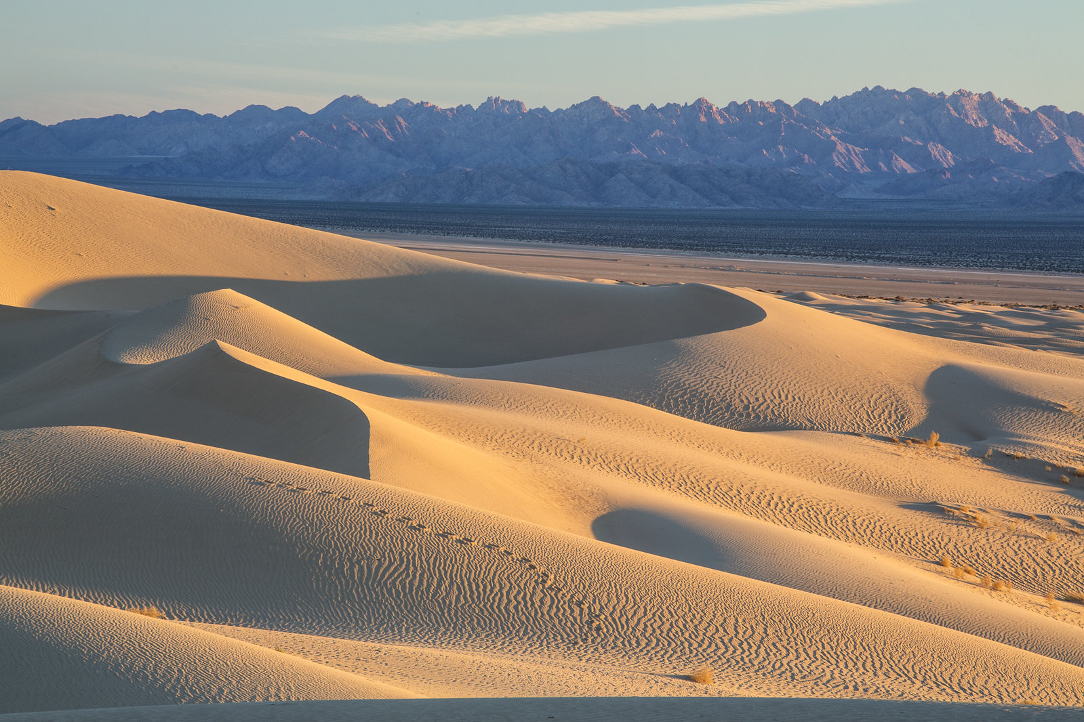
Short-Circuiting NEPA
What does this mean for CLF Friends Groups?
Bigger groups litigating new rules and policies
Help needed watch-dogging projects getting rammed through without adequate NEPA reviews.
Case Study: Mojave Trails National Monument / Cadiz Water Pipeline

Slide 22

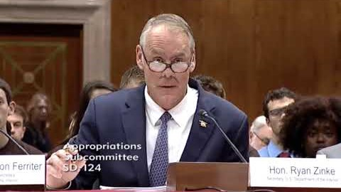
Excluding the Public
22

Slide 23
Excluding the Public
BLM is making it more difficult for citizens to weigh in on public lands decisions.
Shorter comment periods.
Misplaced comments.
Fewer public meetings.
Withholding of FOIA documents
Worst may be yet to come!
23

Slide 24
Excluding the Public
What does this mean for CLF Friends Groups?
Challenges to broad policies being handled by big groups.
Major impacts to your right to participate.
Be aware. Find a friend in BLM. Ask for more time, more meetings, more information. Challenge public participation issues in comments.
24

Slide 25
Fighting TO WIN IN THE TRUMP ERA
Conservation groups are successfully pushing back against the Trump administration
Hard-hitting legal advocacy is holding the line until we secure a better administration
Friends groups can and should employ new advocacy tools to address threats to your public lands
25

Slide 26
Twin Advocacy Goals in the Trump Era
Force Change: administrative and legal action can stop or slow unprecedented attacks
Build Community: outreach and inclusion efforts can increase our tent and impact
26

Slide 27
Stopping Rollbacks
Western Watersheds Project v. Zinke, 336 F. Supp. 3d 1204 (D. Idaho Sept. 9, 2018): Stopped the Dep’t of Interior from cutting the public out of oil and gas leasing on 67 million acres of sage grouse habitat across 11 Western states
Citizens for Clean Energy v. U.S. Dep’t Interior, 384 F. Supp. 3d 1264 (D. Mont. 2019): Dep’t Interior violated NEPA by failing to consider impacts of lifting moratorium on federal coal leasing program
League of Conservation Voters v. Trump, 363 F. Supp. 3d 1013 (D. Alaska 2019): Court reinstated Obama-era oil and gas leasing bans in the Arctic and Atlantic oceans
Utah Dine Bikeyah v. Trump, 1:17-cv-02605: TBD
Lesson: Federal courts and litigation can protect hard-earned victories
27

Slide 28
Defending
your
public
lands
Mar. 2019: Two courts reject BLM lease sales of public lands for oil and gas drilling
Jun. 21, 2019: Court rejected Trump administration’s approval of Cadiz project to build water pipeline in Mojave Trails National Monument
May 2019: Bernhardt defers oil and gas leasing near Chaco Culture National Historical Park for at least a year due to public pressure
June & July 2019: Successful BLM State Director Reviews stop oil and gas pipeline in CA National Monument and oil and gas project in Wyoming
Lessons: Legal and public pressure can stop new threats on NLCS lands
28

Slide 29
Engaging the public and building community
Public support is crucial for achieving and defending legal victories
Unprecedented attention to public lands and conservation policy creates an opportunity for Friends
Advocacy outreach allows Friends to bring new people and communities into our tent
Public comment periods can amplify voices of people who have been historically cut out
29

Slide 30
We are in this together
Advocates for the West and CLF are here to help you navigate the advocacy world
Advocacy Academy webinars can teach you the nuts and bolts of environmental law and advocacy
We can help you identify the most important threats to your NLCS lands and how to respond
30

Slide 31
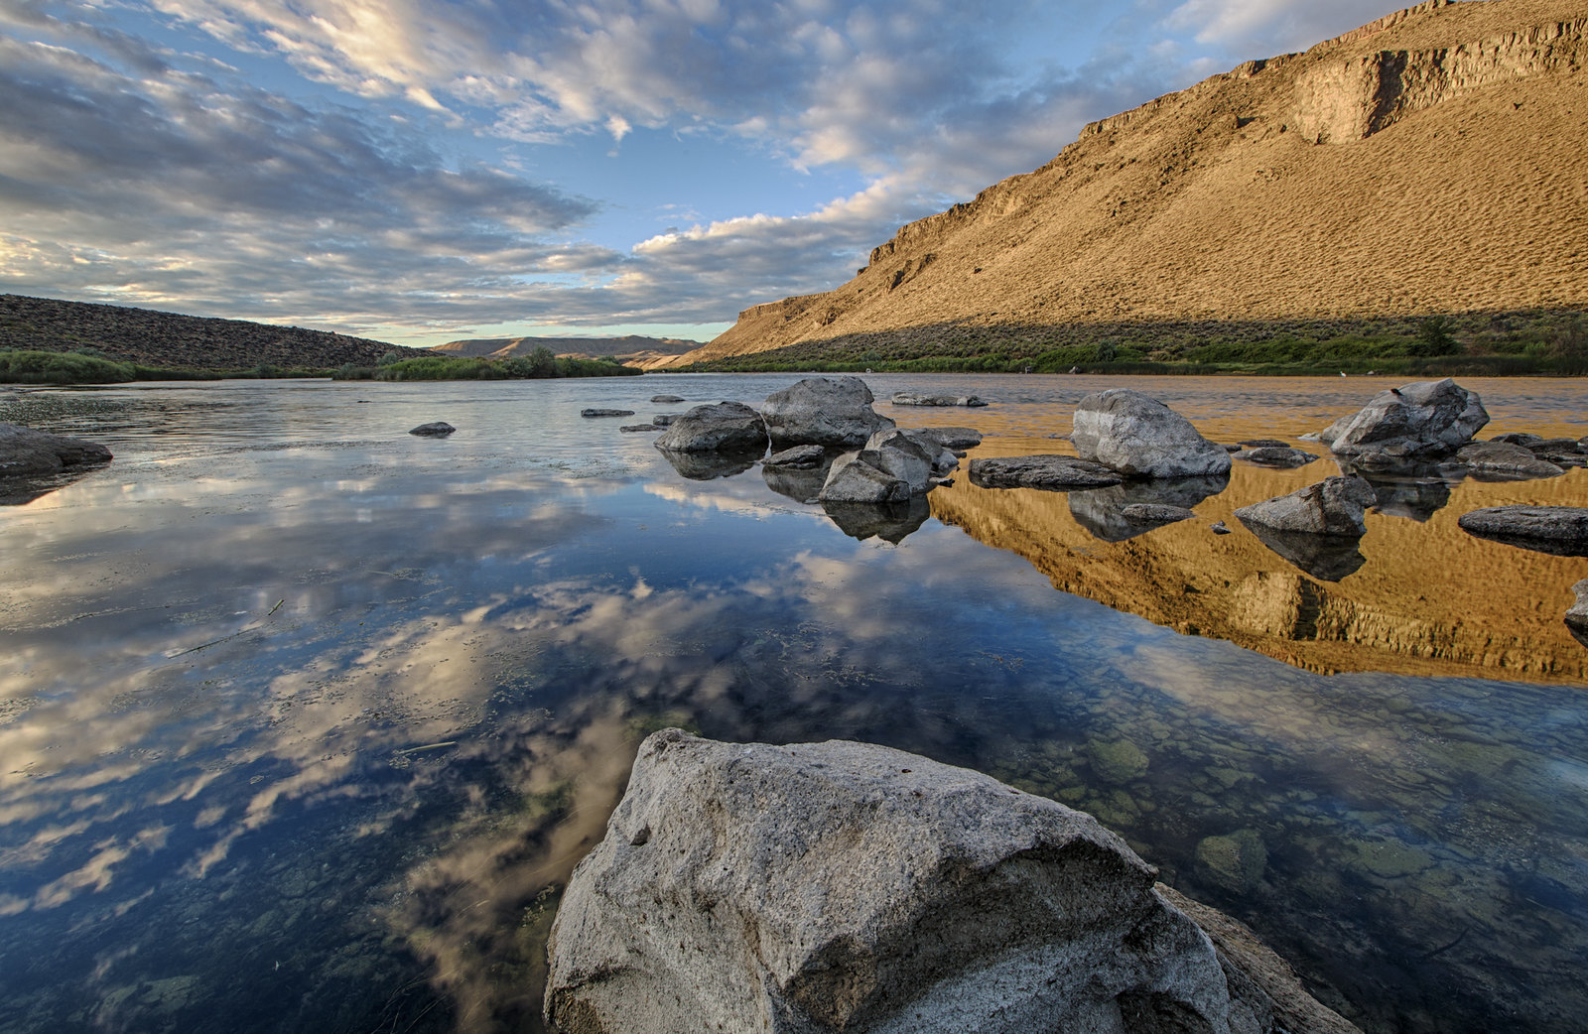
QUESTIONS?
Todd Tucci
ttucci@advocateswest.org
Lizzy Potter
epotter@advocateswest.org
Sarah Stellberg
sstellberg@advocateswest.org

