Slide 1

Election-Season Activity for 501(c)(3)s
Tim Mooney, Senior Counsel
Notes:
1

Slide 2
National association of 120 organizations.
Committed to progressive values and the creation of an equitable, just, and free society.
Advocates for a federal judiciary that advances core constitutional values, preserves human rights and access to the courts, and adheres to the even-handed administration of justice for all Americans.
The leading authority on the laws governing nonprofit advocacy.
Notes:
2

Slide 3





501(c)(3)
Public Charities
501(c)(4)s,
501(c)(5)s, 501(c)(6)s
527 Political
Organizations
Examples
Tax-exempt
Tax Treatment
Contributions
tax-deductible
Tax-exempt
Tax-exempt
Lobbying Activities
LIMITED
UNLIMITED
RARE AND
USUALLY TAXABLE
CANNOT SUPPORT OR OPPOSE A CANDIDATE
FOR OFFICE. MUST BE “NONPARTISAN.”
Electoral Activities
SECONDARY ACTIVITY
USUALLY SOLE ACTIVITY

Slide 4
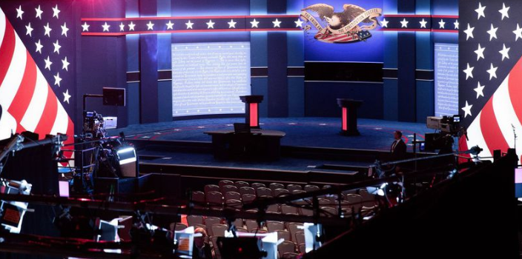
501(c)(3)s can be active participants in election season

Slide 5
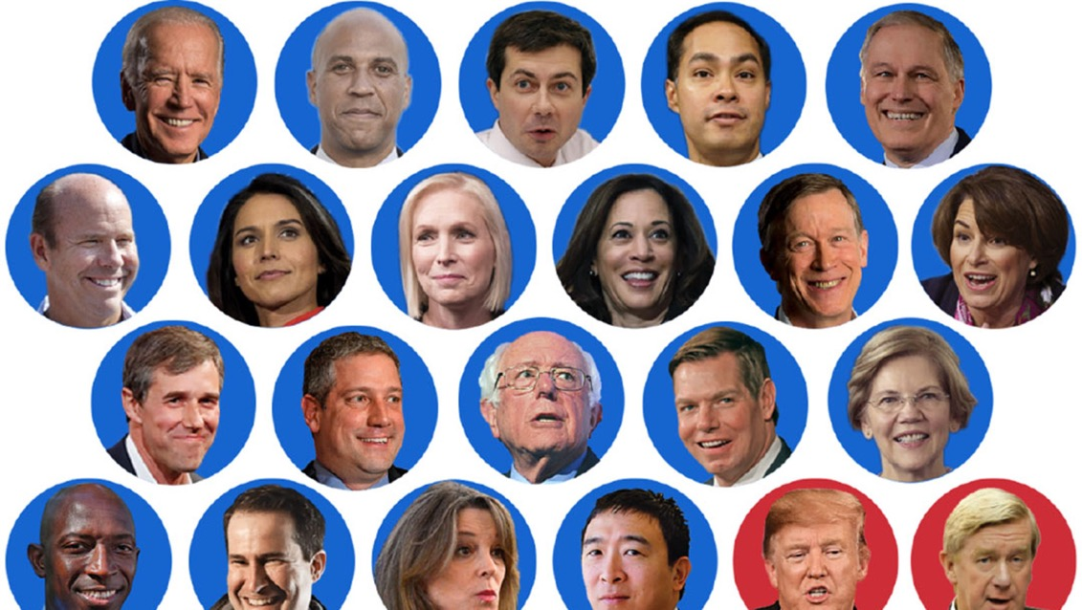
501(c)(3)s cannot support or oppose candidates running for public office

Slide 6
Who is a Candidate?
Includes people:
Officially running
Considering running
Being bandied about in the press
Characteristics of a public office:
Position is created by statute
On-going position – not occasional or contractual
Fixed term
Requires an oath of office
Any level: federal, state or local

Slide 7
Two categories of rules
Safe harbors or areas where IRS has given us guidance
Everything else – facts and circumstances analysis

Slide 8
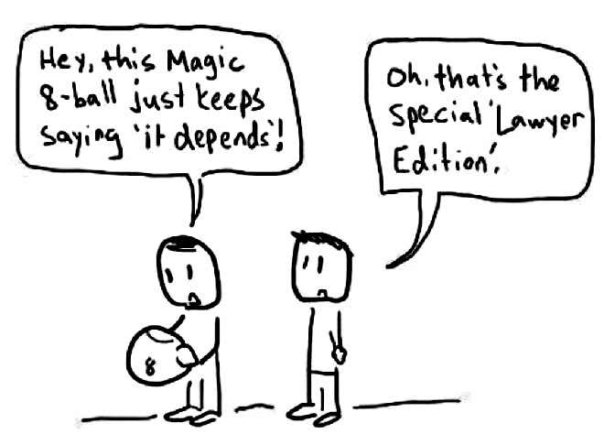
Notes:
Many questions do not have bright line answers. Deciding on the correct route of action can be very fact specific (think of the facts and circumstances test)—gray areas are best navigated by adopting some best practices when engaging in, describing, and tracking and reporting on your work.

Slide 9
Facts and Circumstances Analysis
GOOD FACTS | BAD FACTS
No reference to candidate or elections | Refers to candidate as a candidate
External factor driving timing | Timing motivated by election
Broad range of issues | Politically motivated targeting
History of similar work or communications | Compares candidate to preferred position
Part of a series of similar, ongoing communications | Wedge issue that divides candidates
Good Facts | Bad Facts
No reference to candidate or elections | Refers to candidate as a candidate
External factor driving timing | Timing motivated by election
Broad range of issues | Politically motivated targeting
History of similar work/communications | Compares candidate to preferred position
Part of a series of similar, ongoing communications | Wedge issue that divides candidates

Slide 10
Facts and Circumstances Analysis
Some communications become riskier the closer to an election
Context matters, intent does not

Slide 11
Risk Assessment
High Risk
Some Risk
Low Risk

Slide 12
Social Media
File under, “should go without saying” but…
Rules that apply to print and verbal communications also apply online.

Slide 13
Retweets, likes and links
Be sure you know what you’re liking, retweeting and linking to. The IRS considers everything you directly link as part of your message.
Be particularly careful linking to non-(c)(3) organizations

Slide 14
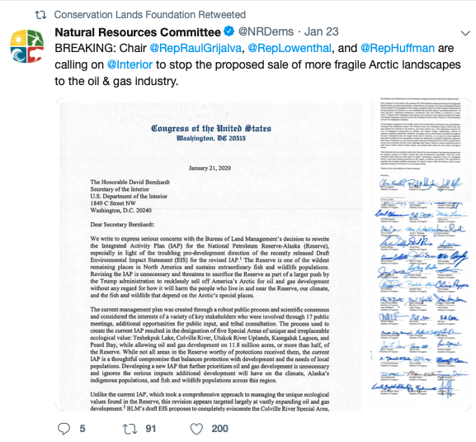
Retweets, likes and links

Slide 15
Following and friending
Be mindful of following and friending non-(c)(3) organizations
Organizations that do non-electoral advocacy are probably ok
Organizations that are purely partisan are probably not ok
Official accounts versus candidate accounts
Ok to follow/friend a lawmaker’s official account
Very risky to follow a candidate account

Slide 16
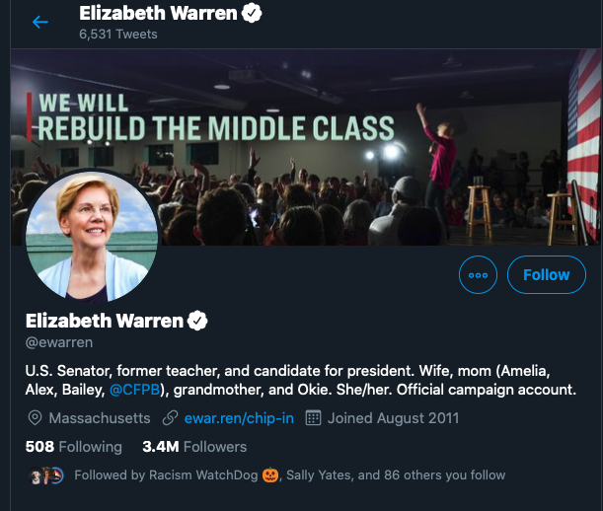

Slide 17
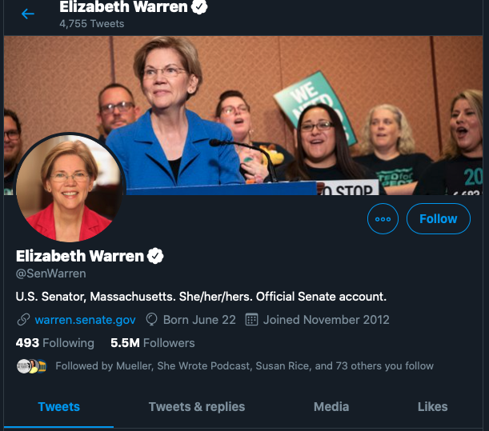

Slide 18
501(c)(3) Election-Related Activity
Voter registration and get-out-the-vote (GOTV)
Voter protection
Issue advocacy
Voter education
Candidate education
Rules of the Game Part 2
February 18

Slide 19
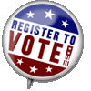
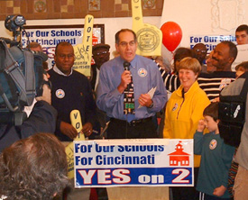
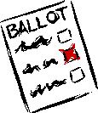
Voter Registration & GOTV
Voter Registration
Enlisting unregistered voters
Get-out-the-vote activities
Anything that gets people to the polls
Keep in mind the permissible goal
Encourage people to exercise their right to vote

Slide 20
Targeting Messages
Permissible to target activities if based on nonpartisan criteria
Location
Audience
May not target based upon the way a group votes
May target because it is a disadvantaged or underrepresented group or the targeted group has a common interest or problem

Slide 21
Targeting Messages
Discuss a broad range of issues
Don’t suggest a correct position
Vote green. Register here.
You can have an impact on the decisions affecting your life. Register to vote now.
Let’s get out the pro-choice vote. Register here.

Slide 22
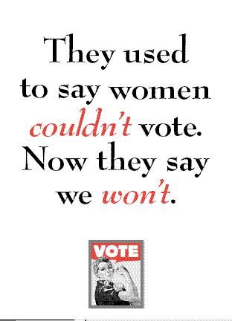
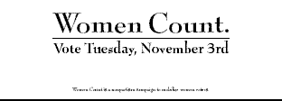

Slide 23

Targeting Messages

Slide 24

Targeting Messages
Special
rule:
lobbying

Slide 25
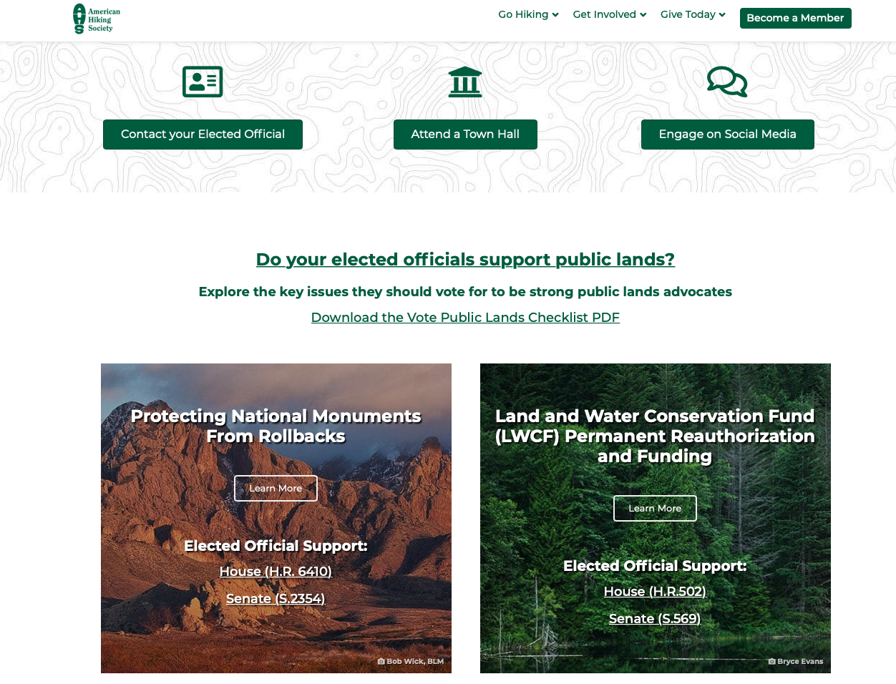
not linked to GOTV, voter reg or election

Slide 26
501(c)(3) Election-Related Activity
Voter registration and get-out-the-vote (GOTV)
Voter protection
Issue advocacy
Voter education
Candidate education

Slide 27

Voter Protection
Ensuring that all voters have an equal opportunity to vote and have that vote count
This can be done in a partisan and a nonpartisan way, so it’s important to make sure you’re involved in nonpartisan Voter Pro coalitions as a 501(c)(3)
There is a robust infrastructure for nonpartisan Voter Pro

Slide 28
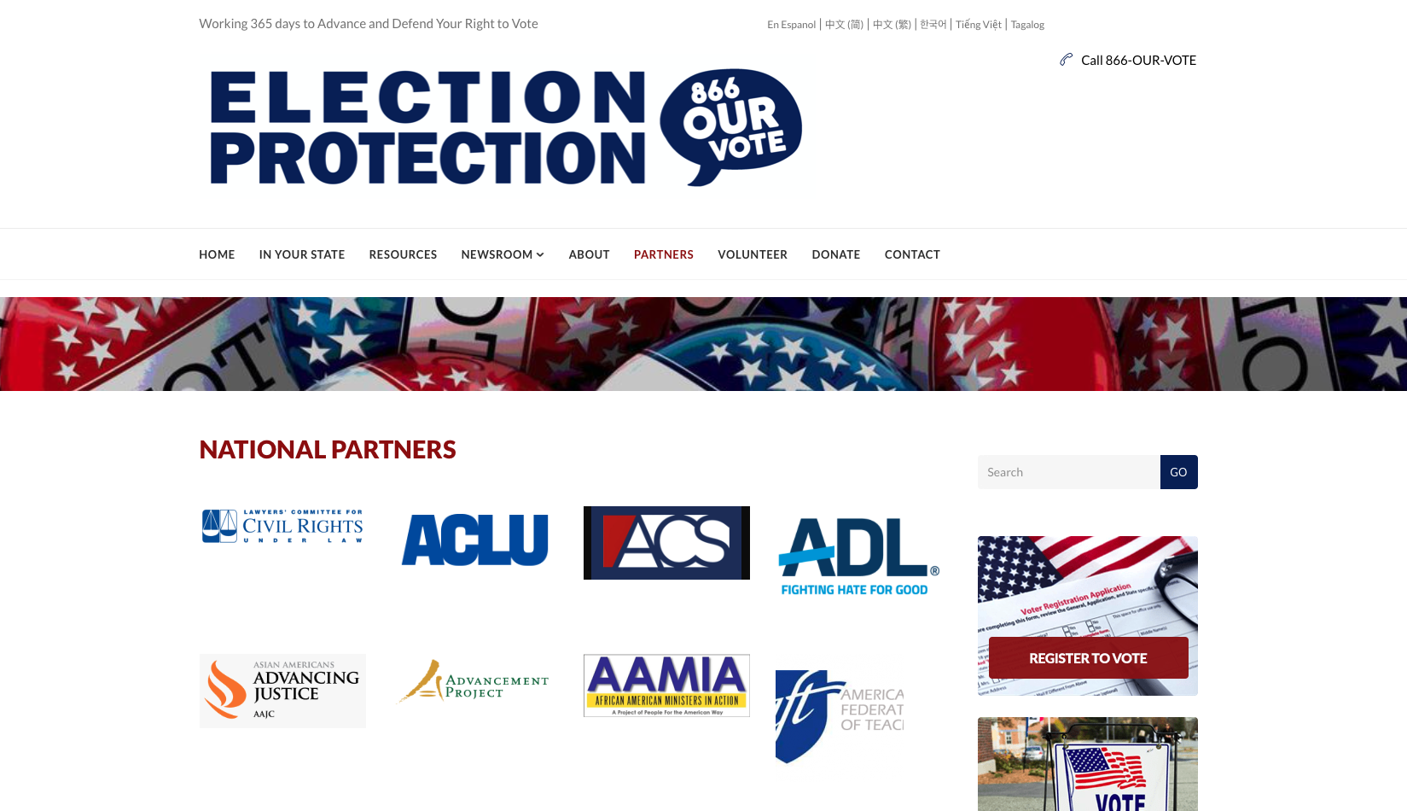
Voter Protection
866ourvote.org
State & local partners

Slide 29




WEST COAST San Francisco
Los Angeles
EAST COAST
Washington, DC
Los Angeles, CA
TEXAS
Dallas
866-675-6229
advocacy@afj.org bolderadvocacy.org @AFJBeBold | @AFJTim
facebook.com/BolderAdvocacy

Slide 30

Questions?

