Slide 1


Working Together to End Youth Homelessness in Canada
Mobilizing Stakeholders to End Youth Homelessness
Melanie Redman
A Way Home
Stephen Gaetz
Canadian Observatory on Homelessness
September 28, 2015

Slide 2
Part 1
What IS

Slide 3
ABOUT US:
A Way Home is a national coalition dedicated to preventing, reducing and ending youth homelessness in Canada.
Putting Youth Homelessness on agenda of decision makers
Public spotlight on Youth Homelessness
Working to align interested funders with our national vision to Prevent, Reduce & End youth homelessness

Slide 4



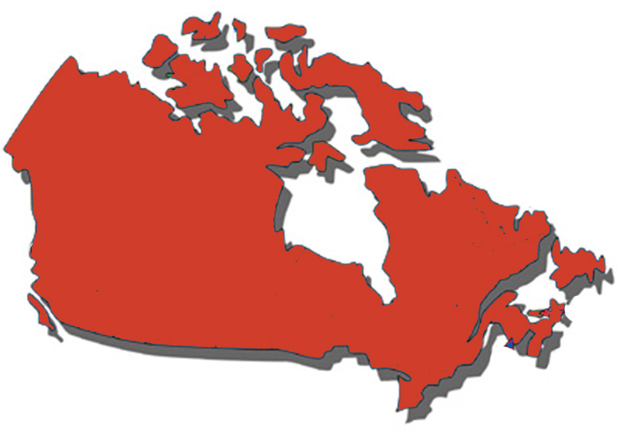




Key National Partners

Slide 5


Funders as Partners

Slide 6


builds on the work of the
Mobilizing Local Capacity
project
2 communities/year, competitive process, pan-Canadian
Year 1 – Kamloops, BC
Kingston, ON
Year 2 – Saint John, NB
County of Wellington, ON
Year 3 – Yellowknife, NWT
Brandon, MB

Slide 7
Shifting Context
1
Conceptual shift taking hold, moving from ‘managing’ homelessness, to “preventing, reducing and ending homelessness”
2
Demonstrated successes in government and community planning
3
Research: Greater knowledge about solutions and effective interventions
4
Enhanced community readiness
5
Increasing collaboration by national partners in supporting those processes

Slide 8
Part 2
Why we need to do this…

Slide 9

Key point: Youth homelessness is distinct from adult homelessness

Slide 10

When we let young people become homeless …

Slide 11
When we let young people become homeless …
Health worsens
Mental health declines
Exploitation
Greater risk of addictions
Involvement with the law
Dropping out of school
Trauma and criminal victimization
Entrenchment in live on the
streets

Slide 12
If the
CAUSES & CONDITIONS
of youth homelessness are unique, so must be the
SOLUTIONS!!!

Slide 13
Responding to homelessness
To this?
Can we move from this?
Emergency
Response
Housing and Supports
Housing and Supports
Emergency
Response
Prevention
Prevention

Slide 14
Part 3
The role of

Slide 15

Government
Relations
Partnership
&
Collaboration
Community
Planning
Key
Constellations
of Activity
Programs
Working Together to End Youth Homelessness in Canada
Community of practice
Public Engagement
Youth
Voice
Research

Slide 16
Government
Relations
Partnership
&
Collaboration
Community
Planning
Key
Constellations
of Activity
Programs
Working Together to End Youth Homelessness in Canada
Community of practice
Public Engagement
Youth
Voice
Research

Slide 17

Considerations for planning
Collective Impact

Slide 18
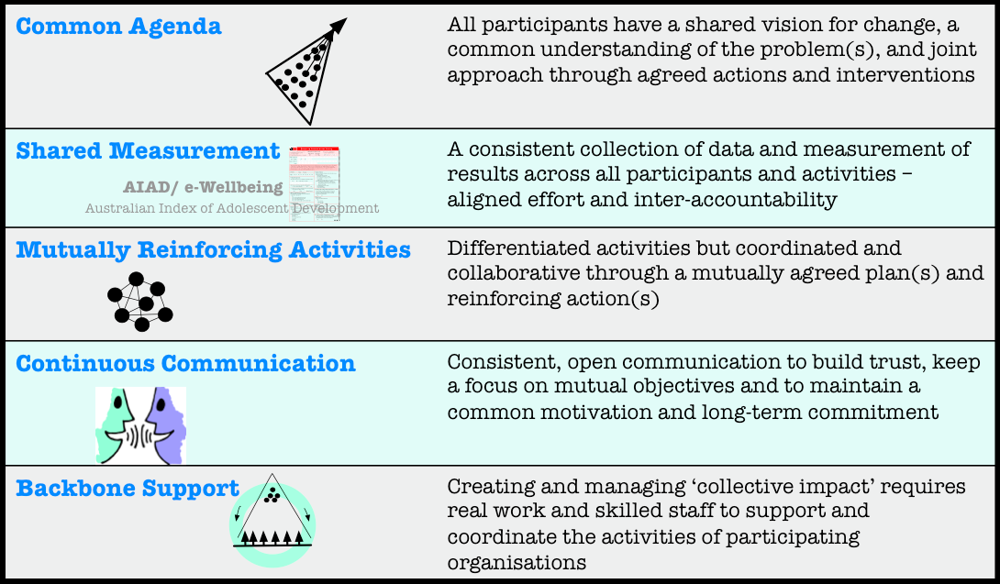
Collective Impact

Slide 19
Government
Relations
Partnership
&
Collaboration
Community
Planning
Key
Constellations
of Activity
Programs
Working Together to End Youth Homelessness in Canada
Community of practice
Public Engagement
Youth
Voice
Research

Slide 20

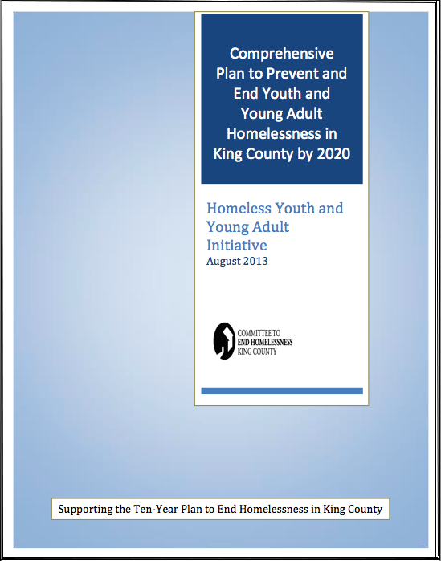

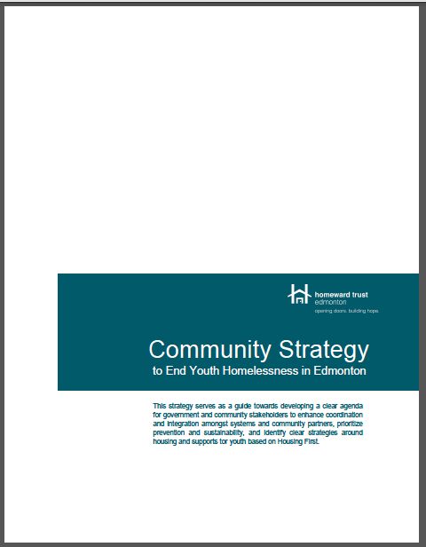

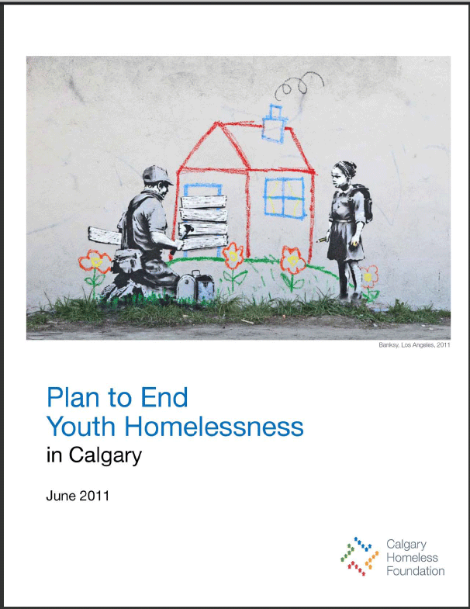
Community planning
Supporting Healthy and Successful Transitions to Adulthood A Plan to Prevent and Reduce Youth Homelessness in Alberta

Slide 21

Implementation Support
Sustainability planning
Communications strategy
Change management
Funder alignment
Evaluation

Slide 22

HELP!?! Technical Support

Slide 23

Resources
Planning resources
Community, Provincial and State Plans
Youth Homelessness Prevention Framework
Youth Homelessness Community Planning Framework
Housing First for Youth Framework
Toolkits
Youth Point in Time Count Toolkit
Youth Engagement Toolkit
LGBTQ Toolkit
Program Model Toolkits
Common Assessment Tool

Slide 24
Government
Relations
Partnership
&
Collaboration
Community
Planning
Key
Constellations
of Activity
Programs
Working Together to End Youth Homelessness in Canada
Community of practice
Public Engagement
Youth
Voice
Research

Slide 25
Aligning state and local efforts
Ensuring that government policy, programing and funding supports community efforts
Community planning and programs

Slide 26
Government
Relations
Partnership
&
Collaboration
Community
Planning
Key
Constellations
of Activity
Programs
Working Together to End Youth Homelessness in Canada
Community of practice
Public Engagement
Youth
Voice
Research

Slide 27
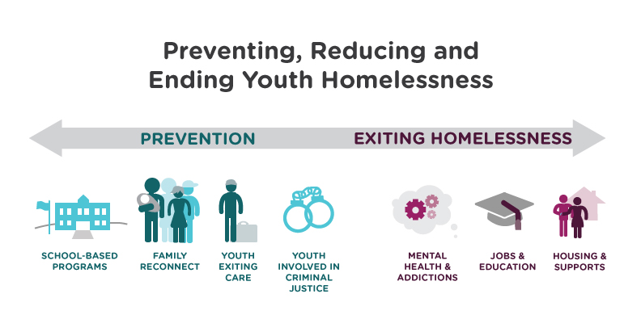
Effective Program Models

Slide 28
Government
Relations
Partnership
&
Collaboration
Community
Planning
Key
Constellations
of Activity
Programs
Working Together to End Youth Homelessness in Canada
Community of practice
Public Engagement
Youth
Voice
Research

Slide 29

Communications Strategy

Slide 30
Government
Relations
Partnership
&
Collaboration
Community
Planning
Key
Constellations
of Activity
Programs
Working Together to End Youth Homelessness in Canada
Community of practice
Public Engagement
Youth
Voice
Research

Slide 31

A National Youth Homelessness
Research Agenda
Incorporating research, data gathering and information
sharing
Notes:
1. Collaboration: Provide opportunities for collaboration among the diversity of groups and researchers involved in homelessness across Canada.
2. Knowledge Mobilization: Make existing research on homelessness more accessible and reduce the geographical, sectoral, and socio-economic divisions that impede knowledge exchange.
3. Public Engagement: ‘Make research matter’ by exploring ways that research can more effectively engage the general public, policy makers and other decision-makers in the homelessness sector.

Slide 32
Government
Relations
Partnership
&
Collaboration
Community
Planning
Key
Constellations
of Activity
Programs
Working Together to End Youth Homelessness in Canada
Community of practice
Public Engagement
Youth
Voice
Research

Slide 33

Youth Engagement

Slide 34
Government
Relations
Partnership
&
Collaboration
Community
Planning
Key
Constellations
of Activity
Programs
Working Together to End Youth Homelessness in Canada
Community of practice
Public Engagement
Youth
Voice
Research

Slide 35

Community of Practice

Slide 36
Part 4
How we work

Slide 37
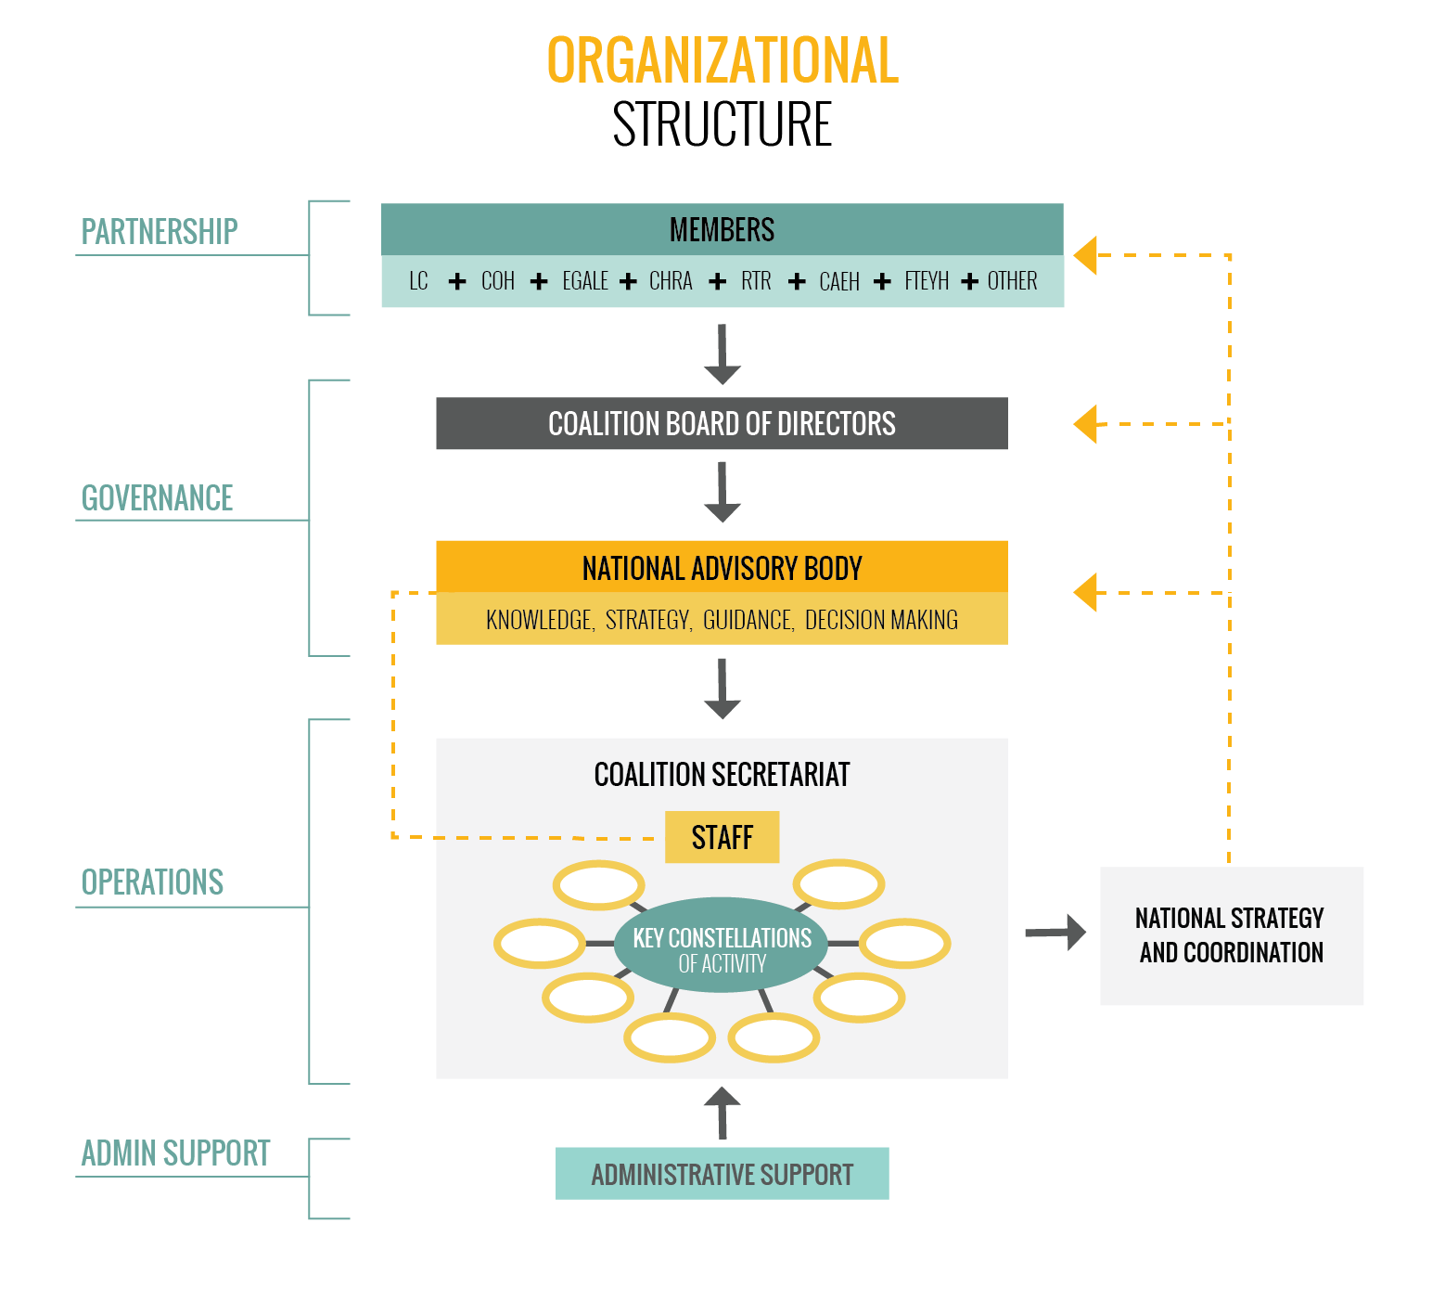

Slide 38

Questions or Comments?

