Slide 1

A Way Home Committee
Community Planning to End Youth Homelessness:
Shelly Bonnah- Chief Operating Officer- Interior Community Services
Katherine McParland- Youth Homelessness Manager- ICS & A Way Home
Notes:
Introduction

Slide 2
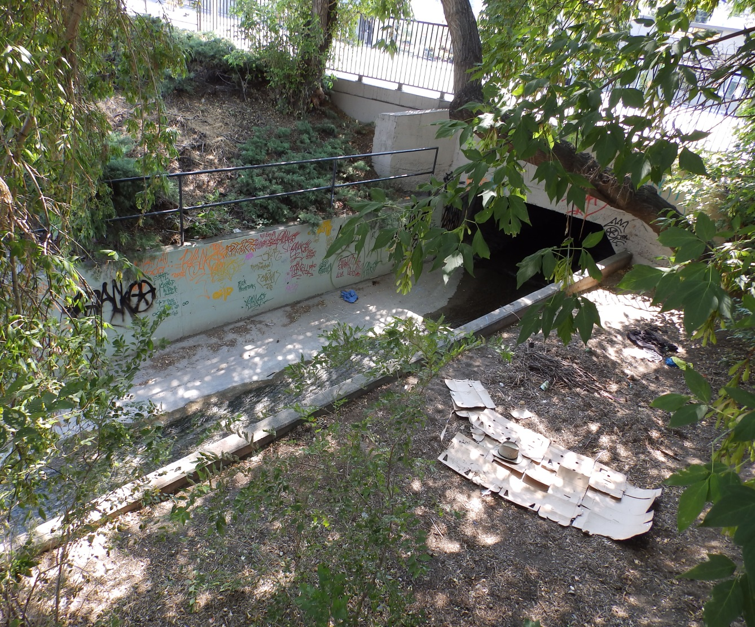
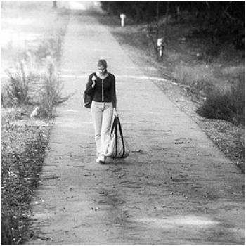
Youth Homelessness in Kamloops
292 Hidden Homeless
20 Absolutely Homeless
Notes:
Explain the epidemic in our community. Absolute and Hidden.
Causes: Adults. 72% of homeless youth in our community are former youth in care.

Slide 3
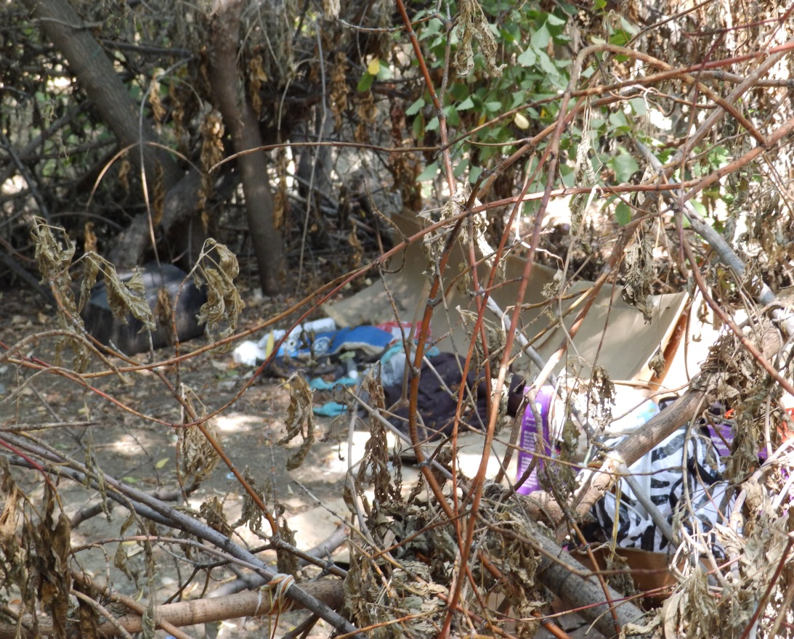


The Importance of First Voices
Notes:
Shelly and Katherine locate themselves and share how they met and homelessness and housing first (maybe same idea as 100 Women).
Talk about how this led to creation of A Way Home.

Slide 4
Former Youth in Care Supportive Housing Committee- Grassroots Community Collaboration.
Interior Community Services
Phoenix Center
Boys and Girls Club
Interior Health
White Buffalo
Ministry of Social Development and Social Innovation
Salvation Army Church
Volunteer Kamloops
School District
Thompson Rivers University
Twin Rivers Education Center
City of Kamloops
United Way
ASK Wellness Society
John Howard Society
Child and Youth Mental Health
Kamloops Regional Correctional Center
AXIS Family Resources
Ministry of Children and Family Development
Secwepemc Families
Kamloops Native Housing
LMO
Canadian Mental Health Association
Notes:
How former youth in care support housing committee came to be. How we got all the partners together.
Impact of having all these partnerships together

Slide 5


Kamloops and the MLC Program
Notes:
MLC program and City of Kamloops partnership. How it was passed from a funder to the community to implement, but still ongoing support from government
how our committee adopted A Way Home and Youth Homelessness Action Plan. Structure created a momentum.

Slide 6

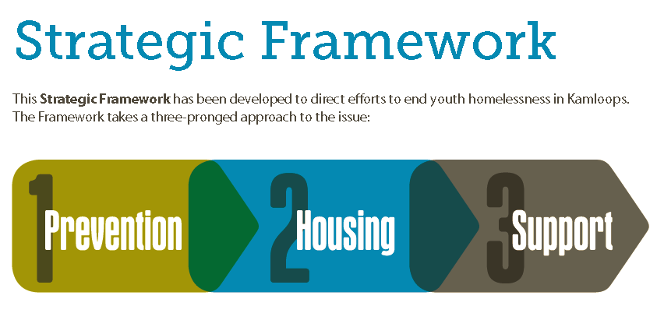
A Way Home Committee Structure
Youth Advisor Chair
Notes:
Explain youth advisor in leadership of larger steering group: Strategy for success is having first voices in leadership at all levels of planning and implementation. Keeps community focused on the true purpose of why we are working together.
3 action teams based on 3 prongs of the plan: Prevention, Housing, Support

Slide 7
Partnerships:
We now have over 70 Partners dedicated to ending youth Homelessness in Kamloops:
Youth-serving organizations
Government services
Business sector
Landlords

Slide 8
Forming & Sustaining Partnerships
We gathered, and have grown by identifying a single common bond:
We are the community that raises the child.
As a committee, we began to work on eliminating the gaps that were contributing to youth homelessness.

Slide 9
The Gaps:
Competiton inherent in funding applications
Lack of trust and communication between service providers
Lack of trust between landlords and youth
Lack of funding (rent) for youth to live independently
Lack of support and life skills for youth to achieve their goals

Slide 10

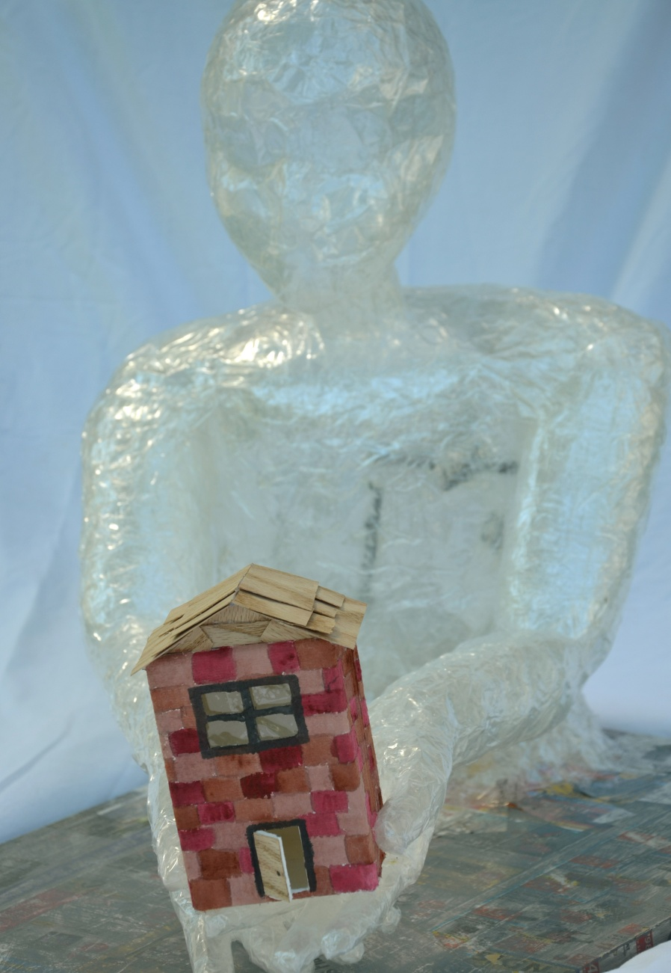
KAMLOOPS YOUTH HOUSING FIRST
WRAPFORCE
New Community Centralized Youth Housing Intake System with Wrap around supports
Notes:
Revolutionized the way our community works together collaboratively.
Model for a community centralized housing process with 15 different agencies. Agencies are not working in sylos. Talk about collaborative competition with funding proposals and how this has been overcome.
Everyone puts their youth, housing and services on the table for equal access to these youth. It becomes the community’s resources. We all have an area of expertise and together we provide holistic support with our different areas of expertise. Ex. housing at Acadia. Concept of reciprocity.
Breaking down barriers that confidentiality can impose= prevent falling thru cracks. Getting back to the roots of it takes a village.

Slide 11















KAMLOOPS YOUTH HOUSING FIRST WRAPFORCE
Notes:
Through the collaborative coordination of 15 different agencies services, we are seeing a ripple effect of ground breaking community development that are reducing the gaps in service and ensuring no youth falls through the cracks. As a community we provide each youth a variety of housing options and a Wrapforce team of different experts in areas of holistic support for these youth.
These agencies have adjusted their services to provide a housing rehabilitation program and bring the support to the youth in their new home for housing sustainability. Many of these youth do not have family & we have the opportunity to create wraparound supports that will simulate this privilege. We need to be the community that raises the children to enact the potential of these youth to contribute to Kamloops.
Within this model, one of our core values is reciprocity where each agency is not only brining their intakes of homeless youth, but they are also giving back to the community’s youth in need of services.

Slide 12



Access to a full housing continuum…..
Transition Housing
Scattered Site Housing
Safe Suite
Youth Acadia
Grace’s Place
Sober Living Unit
Notes:
The Wrapforce also provides a full continuum of housing. Agencies have pooled their housing resources to provide a centralized housing intake system so youth do not need to go to individual agencies in search of housing that best meets their needs. With the Wrapforce, they have access to all housing options.
Transition: stabilization and wellness. Different agencies stretching mandates. Ex. Sober living adult program
Scattered Site: Engaging business sector for a gap. Everyone’s responsibility.

Slide 13


Wrapforce Challenges that have been Overcome
Collaborative Competition
Housing Availability.
Funding
Staffing
Decolonizing our practice
Notes:
Some of the challenges that we have faced working together has been opportunities to help us grow and strengthen our community relationships and partnerships.
Collaborative Competition: Funders proposal process can create collaborative competition among non-profits. We have overcome this by making all agencies’ services, the communities. We are creating proposals with multiple partners, which can be seen as a request from the community. Funders can help us by changing the way the proposal process is done. Partnerships need to be a requirement!!! We know our youth need this and agencies need to acknowledge this collaboration in practice.
Decolonizing our practice was essential for this initiative. The Wrapforce has equal representation of both Aboriginal and Caucaisan descendants. This is unique as often we only see minimal Aboriginal representation and we wanted to ensure this was equal. To do this, we have adapted our approach and acted on feedback from the Aboriginal community. Our intakes look different and our conversations are focused on lineage, heritage, and possible cultural supports. We begin each meeting with a smudge and a recognition of being on traditional territory.
Another challenge has been housing availability. As we want all housing decisions to be made in collaboration and we only meet once a month, sometimes we face the dilemma of having an open unit that we do not want to sit empty till our next meeting. As a team, we have come up with a process where a potential decision is made by the Youth Homelessness Manager who then sends out an email to the Wrapforce who agrees or voices their concerns with this decision. This allows us to house youth faster!
Another challenge is long term funding to help subsidize our scattered site housing units. To overcome this challenge, we have engaged the business sector. We have businesses such as Honda, Home Depot and Subway who are sponsoring youth’s connection to our community.
Our final challenge has been our pursuit of obtaining funding for staffing support within our housing continuum. Community agencies have extended their mandate to provide as much support as possible to youth in the home. We have written proposals as a community collective in hopes of obtaining a staff member to support this initiative. In our future, we see a Wrapforce staff who will help provide case management and coordination of our services.

Slide 14

Wrapforce Successes
15 Different Non-Profit Agencies Coordinating Services Collaboratively.
11 New Youth Transition Housing units created within 3 months.
2 Scattered Site housing first units secured: Home Depot Home and Subway Home
$19,550 raised to date for our Scattered Site Housing program
9 Homeless youth are now housed !!!
Set groundwork for partner action team: Employment Centralized Intake process with Thompson Rivers University and 6 agencies providing Employment Services.

Slide 15




Training Panels for Service Providers Taught by Youth !!!
Community Map of Youth Services
Notes:
Training panels.
Community map.

Slide 16

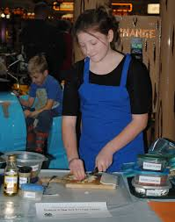



Healthy Transitions to Independence for Youth in Care
Mentorship
Cell Phone Pilot to increase access to housing & supports
Notes:
Group of 15 ppl. Chaired by MCFD
Support to family care network and transitions to independence. Structural shift to include this program in foster parent’s contract.
Mentorship: Team up Project
Cell phone pilot

Slide 17


What happens next?
We are the Community that Raises the Child !!!
Notes:
Conclusion.
“please join us as we rise to be the community that raises the child. I stand rooted in action. Please stand with me.”

Slide 18

For more information on A Way Home:
Please contact:
Katherine McParland
250-320-7837
kmcparland@interiorcommunityservices.bc.ca
Notes:
Ask crowd if any questions

