Slide 1

Mobilizing Local Capacity to End Youth Homelessness
Supporting community and provincial planning

Slide 2
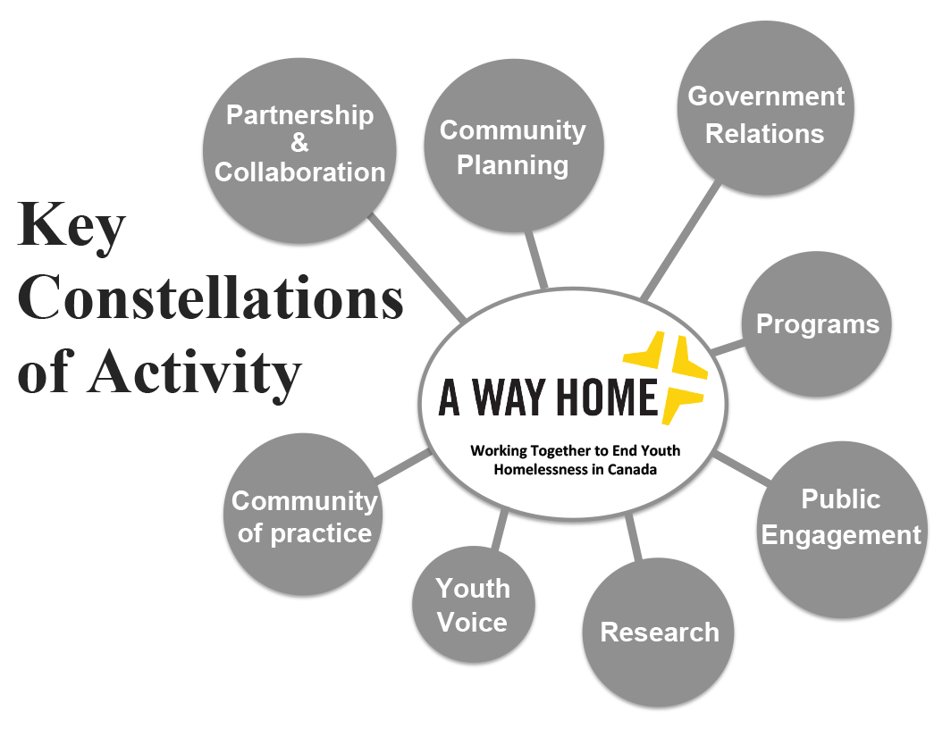

Current – ‘A Way Home’ Grew Out of Community Planning
Notes:
Bringing MLC community planning into national coalition constellation of activity –supported and resourced by national coalition.

Slide 3


3 Years Ago - How to Prevent, Reduce and End Youth Homelessness?
National Partners
Develop Community Plans + Systemic Policy change.
Began with Community driven process, flexible, support with resources.
CDF - Flexible, engaged, knowledgeable funder.

Slide 4

Mobilizing Local Capacity to End Youth Homelessness Program
6 small/medium sized communities from various parts of Canada, with varying stages of readiness, strengths and challenges.
Year 1 – Kamloops BC, Kingston ON
Year 2 – Saint John NB, County of Wellington, ON
Year 3 – Yellowknife NWT, Brandon MB
Notes:
Wet coast, Prairies, East Coast, Far North, Central

Slide 5

Community Planning
Support the Development of Community Plans to Prevent, Reduce & End Youth Homelessness.
Support the Implementation & sustainability of Community Plans to Prevent, Reduce & End Youth Homelessness.
Additional Catalyst Component - Less intensive support for more communities across Canada. (e.g. share tools and resources as developed, etc.)
Notes:
Realized mid way that implementation and sustainability are necessary so built that into the model. Began to think about how to implement plans and catalyse other communities to develop and implement theirs.

Slide 6
Essentials for a Plan to End Youth Homelessness
Communities adopt strategic and coordinated plans to prevent, reduce and end youth homelessness aligned to broader strategies to end homelessness.
Create an integrated systems response/System of Care: The community-based services in the homelessness sector alone cannot solve youth homelessness
Facilitate active, strategic and coordinated engagement by all levels of government / interdepartmental collaboration

Slide 7
Essentials for a Plan to End Youth Homelessness
4. Adopt a youth development orientation: Shift the goal of the work from a “transition to independence” to a “healthy transition to adulthood”
5. Young people are engaged as active partners in developing solutions to youth homelessness.
6. Incorporate research, data management and information sharing

Slide 8
Essentials for a Plan to End Youth Homelessness
7. Incorporate all aspects of an Integrated Prevention Framework:
Primary Prevention (working upstream with families and schools)
Systems Prevention (no discharge into homelessness)
Early Intervention (strategies to address immediate risk of homelessness – family reunification, shelter diversion, coordinated assessment, client- centred case management)
8. Retooling Emergency Services.
9. Continuum of Housing and Individualized Supports.

Slide 9

Throughout the Plan, consider the specific needs and issues facing:
LGBTQ youth
Newcomer youth
Youth with mental health and/or addictions barriers
Aboriginal and other Racialized Youth

Slide 10
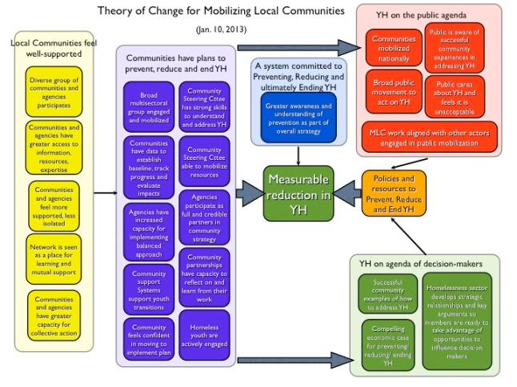
Developmental Evaluation
Theory of Change – Learn as we go.

Slide 11
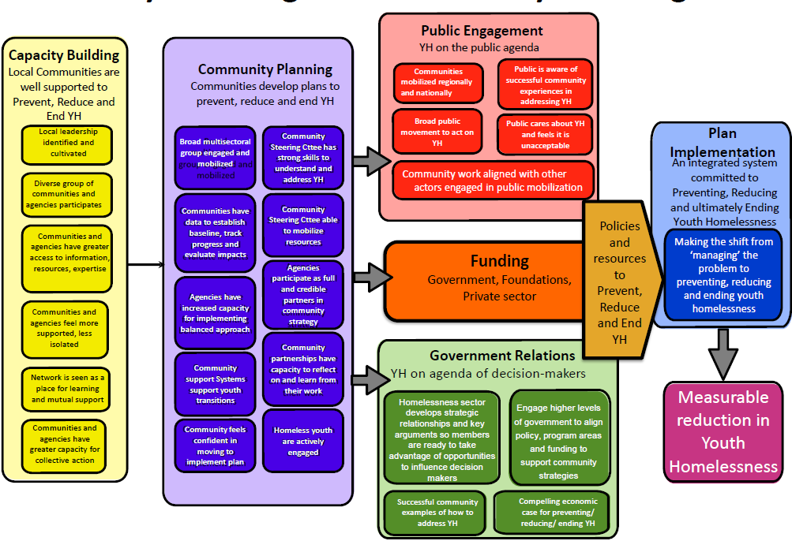
Developmental Evaluation
Theory of Change – Learn as we go.

Slide 12
What happened ???
YH sector paradigm shift became visible in 2013… i.e. youth development, Families First
MLC Communities began to understand YH through systems approach + prevention.
Public Awareness of the issue. Public in MLC communities began to feel YH is unacceptable.
Youth engagement key to driving planning process and engaging local decision makers.
Communities had varying levels of readiness and capacity for process.

Slide 13

By 2015
2 Communities launched plans and began implementation Kamloops and Kingston
3 Communities currently finalising plan drafts.
Saint John, Wellington County, Brandon
1 engaging in stakeholder process
Yellowknife – due 2016 (remote,
North)
Rich learnings,

Slide 14
Challenges
Two communities per year not enough to make impact on YH across Canada.
Communities most successful had at least some of the 5 conditions of Collective Impact in place to begin with.
Competing with other planning processes – local, provincial, homelessness, social, poverty.
Community of Practice challenged by geography and community capacity.
Notes:
MLC great at Service Integration, need additional supports for Systems Integration

Slide 15
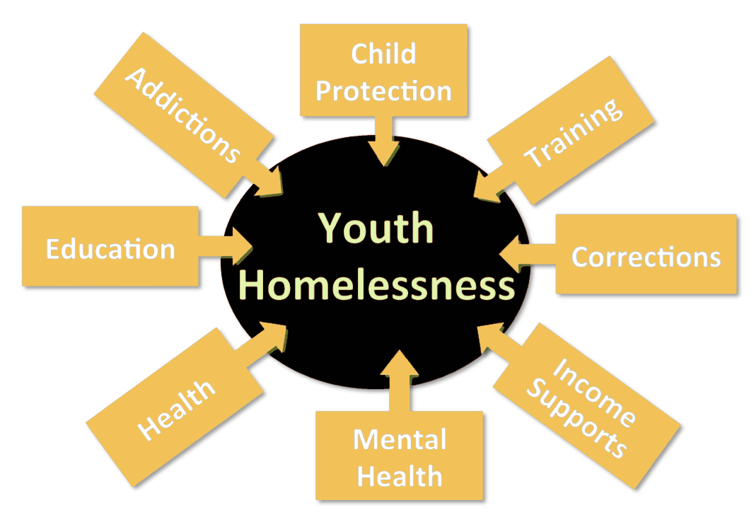
Challenges
MLC community planners without real jurisdiction over Provincial (Fed), drivers of Youth Homelessness.
… a Fusion Policy issue
Notes:
Addressing systems that drive youth into homelessness critical to ending YH but communities had limited influence over this outcome.
Provincial Governments key to ending YH

Slide 16
What Did We Learn???
Resources
Plan Development
Requires more resources than MLC currently provides to develop plans.
Plan Implementation
Infrastructure – staff, governance, convening, evaluation, communications.
Pilot projects, program planning, initiatives.
Resource Alignment.
Local, provincial, national.

Slide 17
What did we learn?
Two areas we should continue strengthen our own capacity:
Systems Planning processes at the community level (communities connecting to larger government systems)
Community Engagement with attention to specific communities – i.e. rural and remote communities

Slide 18
What’s next ?
YH Community Planning Institutes – by province, ensuring community and provincial decision makers are at the table together.
Formalising Collective Impact in our community planning processes by partnering with McConnell’s Innoweave.
Online Community Planning Toolkit – i.e. Framework to integrate YH plans with other planning processes
Templates and tools – system planning, set targets, planning document.
Community Readiness

Slide 19
Community Planning supported by National Coalition to End Youth Homelessness
Notes:
Bringing MLC community planning into national coalition constellation of activity –supported and resourced by national coalition.

Slide 20
MLC Community Implementation & Sustainability
Kamloops -Plan Development Phase Lead organization/backbone City of Kamloops
-Plan Implementation and Sustainability Phase, Lead organization/backbone – Interior Community Services
Katherine McParland, Shelly Bonnah
Kingston
-Plan Development, Implementation & Sustainability
Lead Organization/backbone – United Way Kingston FLA Bhavana Varma

