Slide 1
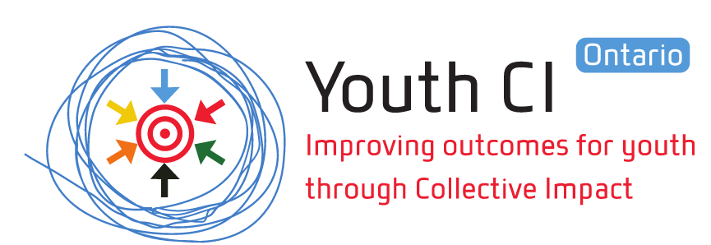
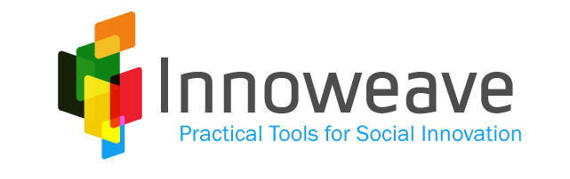

Foundations for Youth Success
Funders Learning Exchange
September 29, 2015

Slide 2
Contents
About Innoweave
Our Collective Impact Learnings
Youth CI and Youth Homelessness

Slide 3
About Innoweave

Slide 4
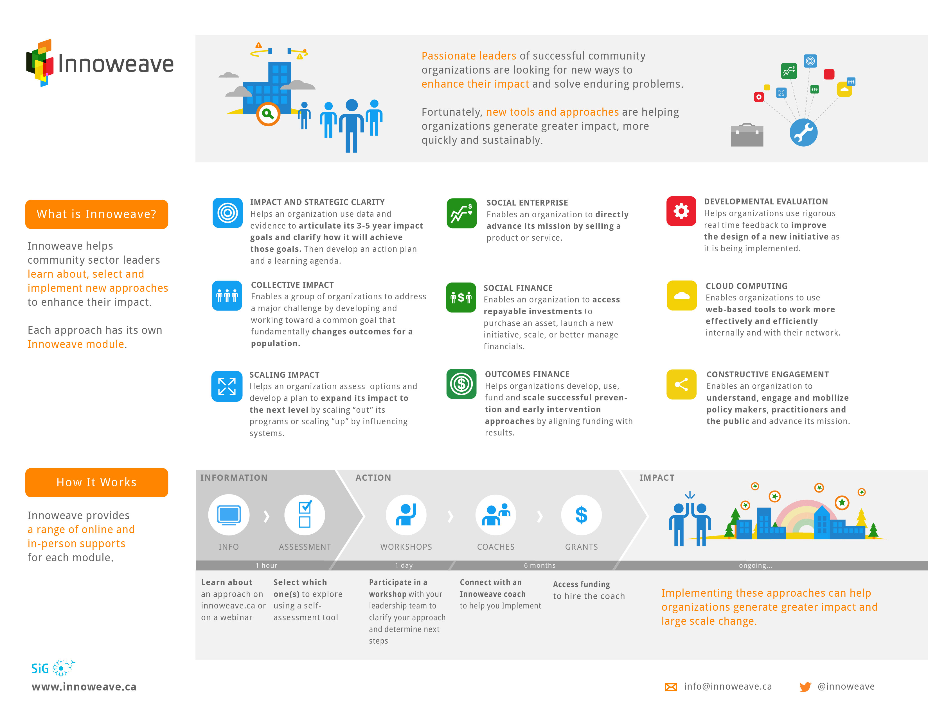
Notes:
RC

Slide 5
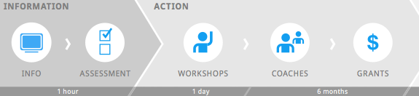
Each module provides 5 levels of support
Learn
Select
Explore
Examine
Execute
RESULTS
KNOWLEDGE
ACTION
Notes:
JR
For each module we offer 5 levels of increasing support
1 sentence on each
1) Dive deeper
2)Then:
This helps orgs move from… (add animation)
Knowledge
Action
results

Slide 6
Our Learnings So Far

Slide 7
What does CI mean to us?
Collective Impact is a means to impact that:
Creates systemic change; or
Solves a large, complex problem through collective action
How can we better convey this understanding to potential users early on?
Defining the Approach
Collective Impact enables a group of organizations to address a major challenge by developing an integrated approach that fundamentally changes population level outcomes in a community.

Slide 8
Collective Impact is very exciting!
Work Together
New Approaches
Better results (outcomes)
Community engagement
Continuous communication
Backbones
Common agenda
Mutually reinforcing activities
Big intractable
problems
New resources
Root causes
Realign resources
Shared measurement
Notes:
Cool concepts
Cool ideas
Cool tools
The theory takes over – lets’ study for a while (grow)
And the tactics take over (Grow measurement, backbones, etc)
There can be more focus on activities than outcomes (outcomes fade / disappear)

Slide 9
Some are falling in love with the process
Community engagement is necessary…
but if unfocussed, can be costly and distracting
Joint leadership is essential…
but can lead to ‘no leadership’
More partners are often required……
but can lead to very broad goals that cannot be achieved
Other partnerships are also valuable
But groups may over-invest in process with no outcome

Slide 10
If we are not careful…
Collective Work
New Approaches
Better results (outcomes)
Community engagement
Continuous communication
Backbones
Common agenda
Mutually reinforcing activities
Big intractable
problems
New resources
Root causes
Realign resources
Shared measurement
Notes:
Cool concepts
Cool ideas
Cool tools
The theory takes over – lets’ study for a while (grow)
And the tactics take over (Grow measurement, backbones, etc)
There can be more focus on activities than outcomes (outcomes fade / disappear)

Slide 11
... the goals can be overshadowed
Collective Work
New Approaches
Better results (outcomes)
Community engagement
Continuous communication
Backbones
Common agenda
New resources
Big intractable
problems
Mutually reinforcing activities
Shared measurement
Root causes
Realign resources
Notes:
Cool concepts
Cool ideas
Cool tools
The theory takes over – lets’ study for a while (grow)
And the tactics take over (Grow measurement, backbones, etc)
There can be more focus on activities than outcomes (outcomes fade / disappear)

Slide 12
Reframed and sequenced model for outcome goals
1. Community level outcome goals
Priority #1
2. A clear model of the integrated efforts required to achieve those goals
Priority #2
Shared outcome measurement and leading indicators
Continuous improvement and communication
Backbone coordination and support
Supporting elements designed to fit with #1 & #2
Designed to measure progress on #1 and ensure #2 works (is a key role played by supporting elements)
Source: Adapted from John Kania and Mark Kramer, Winter 2011
Notes:
Through this process we will help groups develop and implement CI approaches…
Youth CI orgs will join almost 100 collaborate across Canada that we have and are working with to learn about CI and start to develop approaches.
They are ‘defining community level outcome goals…’ etc

Slide 13
Youth CI and Youth Homelessness

Slide 14


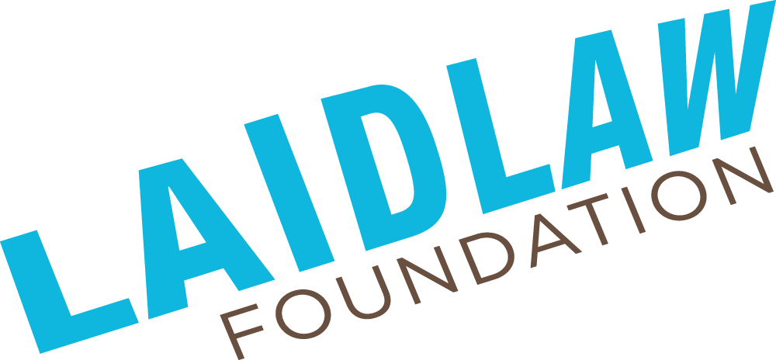
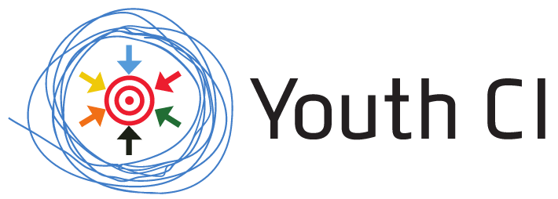
About Youth CI
Youth CI aims to help organizations in local communities across Ontario learn about, develop, launch and implement collective impact approaches that directly improve outcomes for youth in their community.
Youth CI supports communities through a process of information sessions, workshops, coaching and grants to build and execute a successful collective impact strategy.
Notes:
JR
QUICK reminder

Slide 15
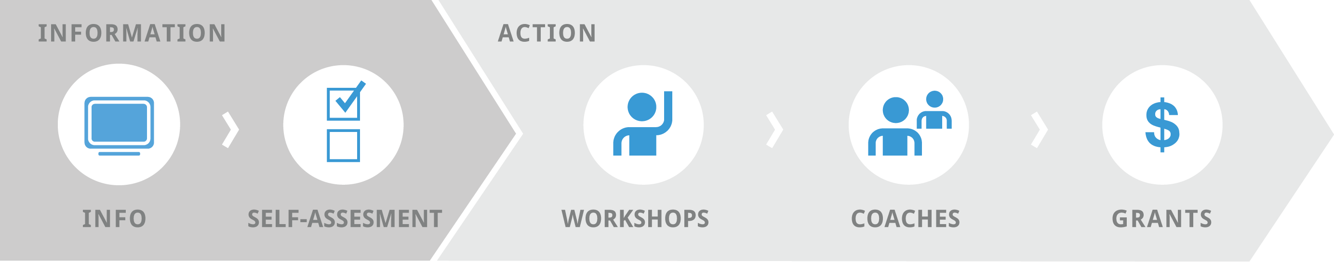
Youth CI process: Overview
Info Sessions
Workshop 1:
Develop the Opportunity
Workshop 2:
Plan for Success
Development Coaching
Planning Coaching
Launch Grants
Execution Grants
Notes:
TI
Keep it high level
TALK ABOUT CONVO STARTER GRANTS

Slide 16
Action: Work towards Theory of Change
Necessary partners to complete them
Necessary and sufficient activities
Population outcome goals
(e.g. end youth homelessness in our community)
Partner A
Activity 1
Partners A + B
Activity 2
Partner C
Activity 3
Partners B + C
Activity 4
Partner D, etc
Activity 5
RESULTS
KNOWLEDGE
ACTION
Notes:
JR
Action → Coaching, workshop 2
Need to have this before final applications

Slide 17
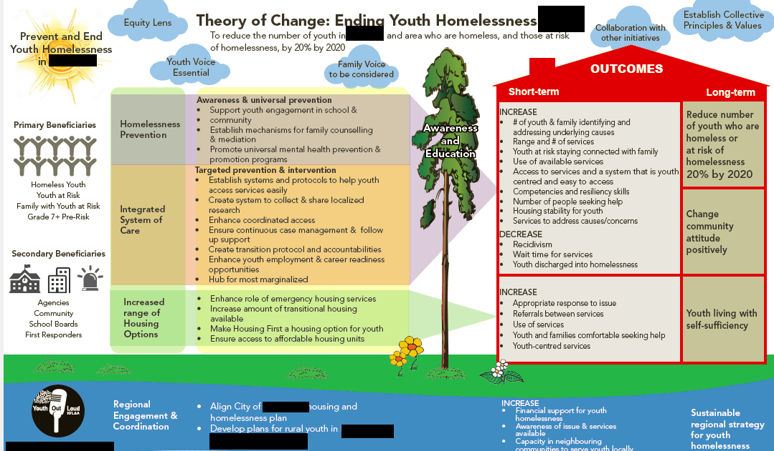
A Theory of Change: Youth Homelessness

Slide 18
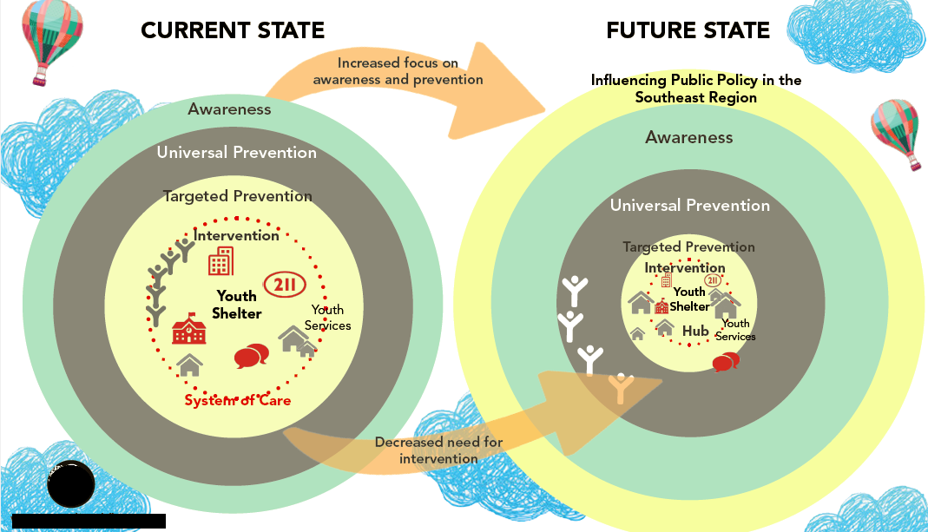
A Theory of Change: Youth Homelessness (cont.)

Slide 19
Thank You!
Notes:
TI

