Slide 1




Slide 2
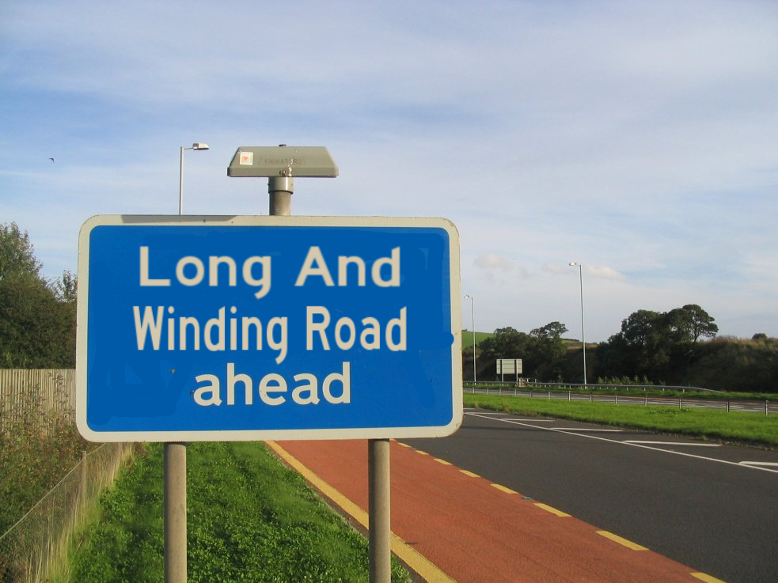

Youth Coordinated Entry in King County
Notes:
Staff, population areas

Slide 3
Youth Coordinated Entry in King County
Why?
Fair and equitable access to housing
Consistent method of prioritization
Housing resources are our community’s resources– CE is essential to having a SYSTEM response
Better understand the need; align resources to meet the need
How can we deliberately and efficiently ensure that the young people most in need of housing interventions are served?
Notes:
Staff, population areas

Slide 4

Evolution
Youth Housing Connection v1.0: 2013-2014
Youth Housing Connection v2.0: 2015-2016
Coordinated Entry for All: 2016-

Slide 5

Youth Housing Connection v1.0
- Launched with private funding in 2013
- Structure:
Operated by contracted provider
Assessments by contracted provider at locations around County
Centralized referrals
Includes young adult housing- not shelter, - not youth programs
Eligibility-age 17.5-24, homelessness/ imminently at risk
Community- developed assessment tool
Referral based on program eligibility, prioritized by vulnerability score & assessment date

Slide 6
Youth Housing Connection 1.0 - Lessons
Young people are successfully able to access assessments, and more vulnerable young people are contacted for housing
Complicated system
Screening criteria & eligibility = problem
Delays, long waitlist, slow timelines, concerns re: occupancy
Questions re: assessment tool
Providers don’t like loss of control
Data system limitations affect daily operations & ability to understand performance, outcomes
YHC at Year 1- we have a problem!
In focusing on equity, did we forget about efficiency?
Previously existing problems highlighted

Slide 7

Youth Housing Connection 2.0
- Changes to structure:
Operated by All Home
Assessments by 10 YA agencies
Centralized referrals (unchanged)
Minor changes to assessment tool, eligibility, what’s in/ out, data system
Began work on reduced screening criteria
Improvement Science

Slide 8

Youth Housing Connection 2.0 - Lessons
Timelines got better…at least we think so
Data system still limited
Providers still frustrated, but less so-improved communication, many meetings, reduced delays…and acceptance?
System remains siloed across populations

Slide 9

Coordinated Entry for All
New structure unites CE for all populations:
Operated by King County– funder
Centralized referrals
Assessments at Regional Access Points and YA agencies
New assessment & prioritization:
TAY VI SPDAT- consistent tool
Prioritization based on vulnerability with banding
New data system-- integrated in HMIS
No changes to eligibility for YA, what’s in/ out
Additional key changes
Moving toward housing people, not filling beds- client choice
Ability to access resources in multiple systems
Reduced screening criteria, streamlined eligibility

Slide 10

Coordinated Entry for All- Ongoing Lessons
Better data system, but it’s a journey
“Additional key changes” (previous slide) still somewhat theoretical– also a journey
Still a complicated system with delays
New assessment tool, still not loved
Meeting the needs of high needs YA
Changes to governance and stakeholder involvement

Slide 11

Continuing to evolve
Learning:
Quarterly Data Reviews
National youth learning collaborative through MANY
Is a more integrated system youth friendly?
Future:
Link to diversion
Navigation support
Inclusion of YA shelter?
Changes to prioritization?
Housing placement meetings/ by name list?

Slide 12
Coordinated Entry:
really hard, really important
Daylights existing issues
Screening criteria create barriers
CE doesn’t create new resources, but highlights unmet needs
Efficiency and equity
Ownership matters--- funder relationship

Slide 13
Carrie Hennen
Carrie.Hennen@allhomekc.org
allhomekc.org

