Slide 1




Slide 2

All Home
ALL HOME is a community-wide partnership to make homelessness in King County rare, brief and one-time. We bring together local governments, religious institutions, non-profits, philanthropic organizations, shelter and housing providers, the private sector and engaged citizens in a coordinated effort that both responds to the immediate crisis of homeless individuals and addresses the root causes of the problem in our region.
Our VISION is that homelessness is rare in King County, racial disparities are eliminated, and if one becomes homeless, it is brief and only a one-time occurrence.
Notes:
Staff, population areas

Slide 3
All Home Youth and Young Adult (YYA) Initiative
All Home staff== planning, coordination, “backbone” support, convening partners including:
Providers
shelter, drop in, transitional housing, long term housing
Public funders
Private funders
Other partners
education & employment, youth advocates, juvenile
justice partners, etc.
Comprehensive Plan issued in 2013, updated in 2015
Notes:
Staff, population areas

Slide 4
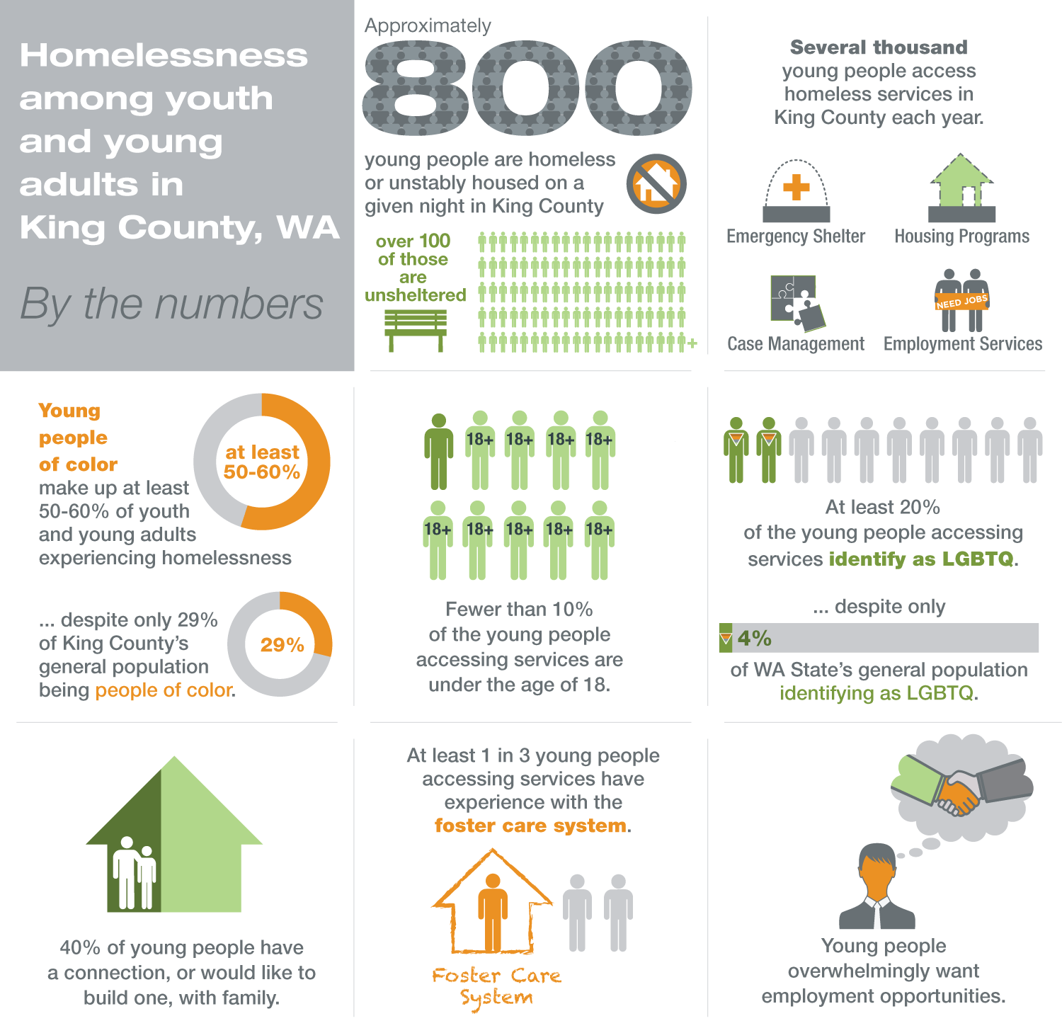

Slide 5






OUR VISION
 | Fewer young people will be unsheltered and literally on the streets.
 | Young people experiencing homelessness will be placed quickly in housing that is supportive and cost effective. When homelessness does occur, it will be a one-time experience.
 | We will have an efficient coordinated entry system. We will have diverse housing models to meet needs of young people.
 | LGBTQ young people and young people of color experiencing homelessness will receive culturally competent services and achieve outcomes on par with their peers.

Slide 6
Highlighted Strategies- Rare
What we’ve done….
Juvenile justice-- Increased collaboration
Child welfare- Implementation of targeted programming for young people aging out of foster care
Family reunification & engagement
What we need to do more of...
All of the above!
Schools- partner on early identification and intervention
Family reunification & engagement– learn what’s effective!
Best Starts for Kids prevention efforts launching soon
Notes:
Examples of strategies we are implementing/ have implemented

Slide 7
Highlighted Strategies- Brief & One Time
What we’ve done….
Additional young adult shelter
Diversion- flexible funding- just launched
Added new employment services for homeless young people
What we need to do more of...
Fully implement diversion
Ensure young people in housing are connected to education & employment, more strongly connect to Opportunity Youth efforts
Meet needs of under 18 youth
Notes:
Examples of strategies we are implementing/ have implemented

Slide 8
Highlighted Strategies- Housing and Access
What we’ve done….
New housing:
Rapid Rehousing
Host Homes
Additional low barrier housing
Coordinated Entry
What we need to do more of...
Support providers in fully adopting Housing First
Meet needs of young people with significant mental health needs
Improve performance– length of stay, exits to permanent housing
Improve Coordinated Entry
Notes:
Examples of strategies we are implementing/ have implemented

Slide 9
Highlighted Strategies- Disproportionality
What we’ve done….
Data disaggregation– race, sexual orientation
Project EQTY– capacity building for YYA organizations in serving LGBTQ youth
Needs assessment of youth of color– launching now
What we need to do more of...
Identify next steps re: serving youth of color based on needs assessment
Notes:
Examples of strategies we are implementing/ have implemented

Slide 10
Measuring Progress
Quarterly dashboards
Rare, brief, one-time, data disaggregated by race and ethnicity
Youth- specific point in time count
Annual
2016- participating in Voices of Youth Count
Evaluate success of new programs, pilots, etc
Notes:
Examples of strategies we are implementing/ have implemented

Slide 11
Broader Context
State of Emergency– homelessness is a crisis in our community
System Transformation recommendations
Performance based contracting
funder driven system
focus on literally homeless and long term homeless
Notes:
Examples of strategies we are implementing/ have implemented

Slide 12
Carrie Hennen
Carrie.Hennen@allhomekc.org
allhomekc.org

