Slide 1
Schools as Anchors:
CPS Facility Reform
By Cecile Carroll-De Mello

Slide 2
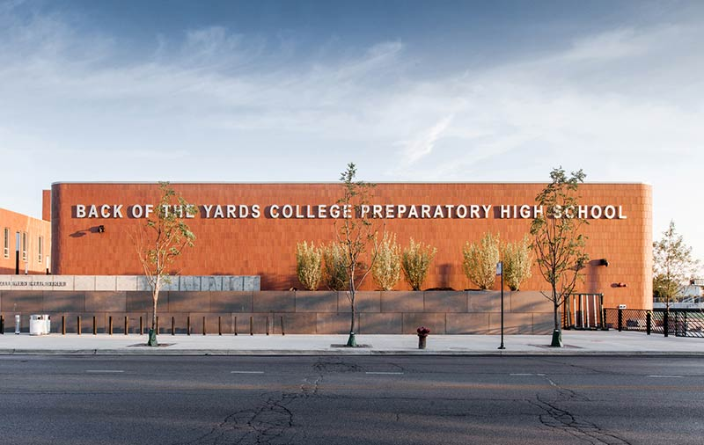
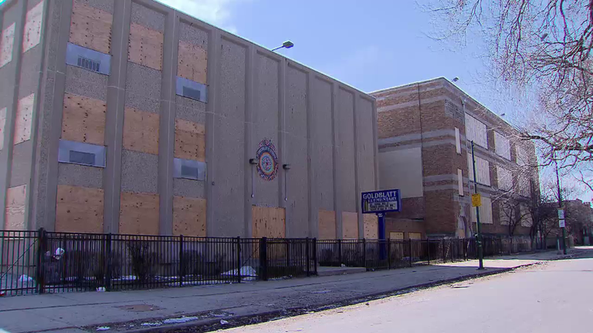
Facilities in education
Facilities encompass all buildings that a district has authority over such as vacant buildings, leased buildings, and operated buildings that house students and programming.
CPS has policies and practices that maintain these buildings, and with that, what happens in these buildings like the academic programming and capacity of student enrollment.
This means a school’s capital repairs, programs that can or can not exist in a building, expansions as well as reductions and all of this impacts the district as a whole, can impact multiple school communities at a time, and impact the financial condition of the district

Slide 3
School Openings- Impact on Communities and Schools
School openings are usually to serve a growing community that needs more capacity to meet the school aged population.
Charter school expansion near low enrolled schools and overcrowded schools.
School openings are paid for through CPS Capital budget and balancing new school capital costs can impact the CPS budget overall.
The district has closed schools and opened schools in the same facility, if the school was a new charter the capacity may be different then the previous school capacity.
The district also opens schools to relieve overcrowding.
The district can also determine only an addition is needed to relieve overcrowding.
New Schools with new academic programming, which include new magnet and selective enrollment schools.

Slide 4
School Closures- Impact on Communities and Schools
The district has closed schools for underperformance, underutilization, or poor facility conditions. These school closures automatically impact surrounding school enrollment. Such as increasing a nearby school’s enrollment-as an official and unofficial receiving school.
Since the start of Renaissance 2010 many schools were closed. The overall message was that the City leadership was closing schools because of underperformance -when many of the schools were closed for under enrollment and were high performing schools in low income communities of color facing gentrification and depopulation.
Utilization/enrollment are the most common reasons for school closures, under enrollment has been considered at times 50% or less of the District's utilization based on the school’s capacity.
Capacity is calculated by number of students to classroom space, minus 25% of space for auxiliary and diverse learning space accommodations- can leave some schools with a disadvantage based on student population and program needs for students.
Neighborhood school replacement by Charter Schools has been connected to issues with Capital costs and misalignment by opening schools that have complicated attendance at Neighborhood schools, and many times added enrollment need that has yet to be filled despite the Capital investments made.

Slide 5
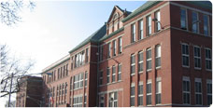
Example of Utilization Formula:
Ryerson Elementary School
Utilization Rate is not 58%
Total Classrooms= 31
Total homerooms= 19
Special ed classrooms= 4
(Over 50 Special Ed students)
Total program rooms= 10
Program rooms includes:
2 -Classrooms converted for a Library
1- Classroom used for a Health Clinic
2 -Classrooms used for recess and community partners
1 -Classroom used as a fitness center for students, parents, and staff
2 -Classrooms used for computer lab/ Reading Lab
1 -Classroom used for science lab
1 -Classroom for Art classroom
1- Parent room
19 Homerooms + 4 special education rooms + 10 program rooms=
24 classrooms utilized/ 31 classrooms =
Utilization is 77% Efficiently Used

Slide 6
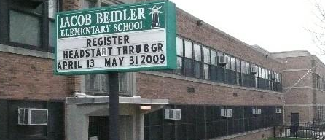
Beidler Elementary School
Not 58% Utilization
Total Classrooms= 33
Total Homeroom= 20
Special Education Rooms= 4
Total Program Rooms= 7
Program Rooms Include:
1 Classroom for Discipline and Mentoring program for Boys
1 Classroom for Music
1 Classroom for Art
1 Classroom for Computer Lab
1 Classroom for Parents
1 Classroom for Community members
1 Classroom for Counselor, Nurse, and Psychologist
20 Total homerooms + 7 Program rooms + 4 Special Education rooms =
31 Total Classrooms Being Utilized/33 Total Classrooms=
93% Utilization

Slide 7
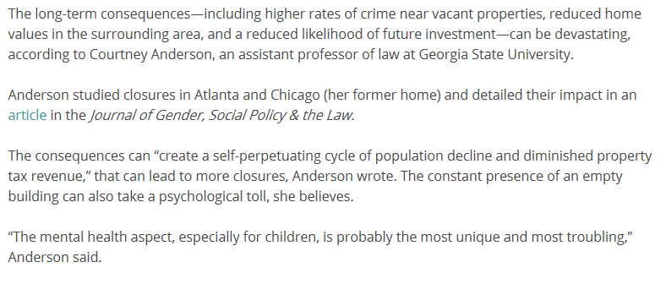
Vacant Schools and Leased Space
Vacant schools have been the result of mass school closures but there has been no immediate reuse for the majority of those vacant schools.
CPS has a number of leased buildings in previously closed buildings, with some immediate turnaround that include Charter schools moving into closed schools within a matter of months. All CPS Charter schools lease these buildings for $1 a year.

Slide 8
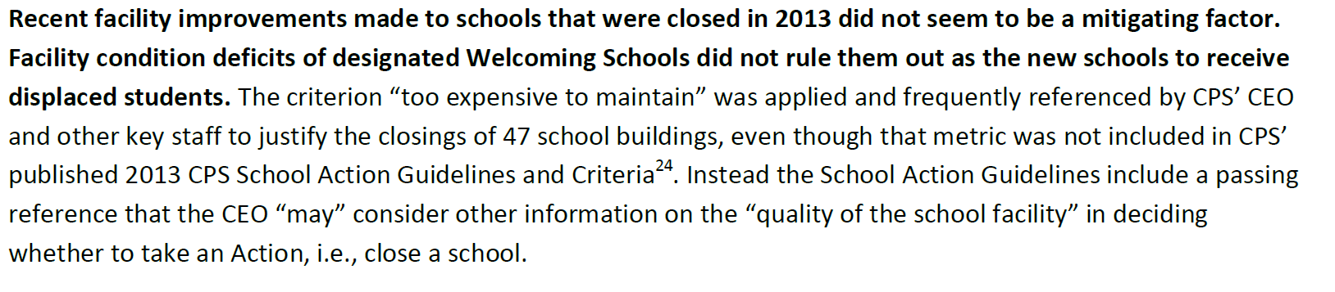
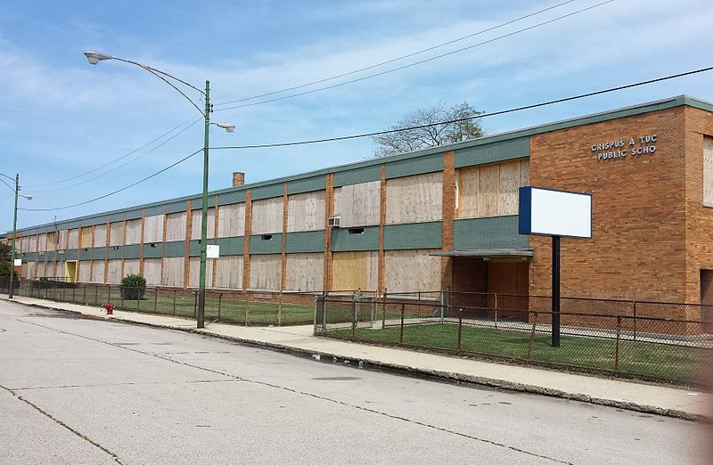
Building Repairs
CPS building repairs happen through their CPS Facility process, it addresses critical repair needs, and new schools’ construction costs.
CPS capital budget is separate from the operating budget.
Additionally some schools have closed with school repair needs apart of the justification.
There is a lack of transparency in which schools and why they received capital dollars. There are have been non-essential investments in schools while other schools needed essential repairs.
Building repairs support optimal learning conditions like air conditioning in schools, libraries, science labs, and IT infrastructure repairs.

Slide 9
In 2011 legislation was passed to improve the Facility management process
Before Public Act vs. After the Act
School Closure reasons varied
There were no public documents that showed specific Capital investments
There were no long term publicly available plans for the academic and facility future of schools and communities
Many school buildings did not have repair investments in years for critical needs and there were no regular facility inspections
The utilization formula was used as a blunt instrument tool
Community meetings for school actions were not convenient
There were no transition plans
School Closure Criteria is made publically available in October and community input is collected on the criteria
Capital Budget is made publicly available to show current and future capital investments
Facility future plans shown with a 10 year facility plan and future academic and building plans
Building repair information for every CPS school is available with needed repairs on the CPS website
School closure notification is now publicly notified by December 1st of every year
Utilization policy can be updated every January
Multiple community meetings for any school actions that do happen
Transition plans created for every school action

Slide 10
CPS Mandated Facility Standards
https://cps.edu/About_CPS/Policies_and_guidelines/Pages/facilitystandards.aspx
Publish space utilization and facility performance standards;
Produce plans for capital improvement (May 2, 2012) and a ten year educational facilities master plan (January 1, 2013);
Ensure that information regarding capital expenditures and leases are accessible to the public
CPS is carrying out a multi-pronged plan to better support our schools in the new school year — including adding additional custodians, conducting monthly inspections to hold vendors accountable and transitioning all schools to a stronger facility services structure — and we are committed to working with school communities throughout the city to ensure all students have access to a high quality learning environment.
The District has developed Facility Performance Standards to provide guidance for future renovations and new construction projects.
Development of an Educational Facilities Master Plan (EFMP) is a requirement of Public Act 097-0474.
A list of properties owned and leased by the District is now available via a searchable database that includes address, property name, Zip code, own/lease categorization, and copy of leases where applicable.
CPS will assess the capital needs of its facilities through:
A Self-Assessment form completed by school administrators and
A detailed biennial assessment of each facility operated by the district

Slide 11
Illinois House Bill 5721- 2018 Facility Reform Legislation
Requires CPS’ 10-Year Educational Facilities Master Plan (EFMP) to include specific facility plans and goals to meet the space-sensitive needs of Special Education, Early Childhood, Career & Technical Education programs, and any other programs with particular space needs. This provision will ensure that CPS’ long-term planning will now incorporate more detailed data to support planning for academic success of all students..
Creates a communications and community involvement plan for each Chicago community, including engagement of students, school-based personnel, parents, and key stakeholders throughout the community to ensure greater public input into CPS’ long-term planning for schools in communities, and to minimize facility decision making that negatively impacts students.
Requires CPS to do advance planning with schools and communities to prevent the creation of vacant school buildings.
Requires CPS to work with school communities experiencing under-enrollment to increase and strive to maximize student enrollment in existing schools through a variety of measures, including:
Enhancement and marketing of educational programs, adjustment of school attendance area boundaries, and identifying and refraining from steps that would exacerbate further enrollment decline. When schools have excess capacity, CPS must work with school community stakeholders to create and implement Joint Use and Community Use agreements that maximize the public and beneficial use of space available in existing schools.

Slide 12
CPS Response to SB 5721- Fall 2018
● CPS established a $10 million Small Schools Fund that provide supplemental resources to 129 schools to help ensure students receive a rich academic experience and assist schools in retaining and attracting students.
● CPS provided $5 million in supplemental funding to protect schools that would otherwise lose more than 3 percent of SBB funding — even if they saw a significant enrollment drop between the fall of 2016 and the fall of 2017. This protection has helped ensure that significant enrollment declines do not result in dramatic funding changes at any school.
● In accordance with a new state law, the Board of Education passed its first Under-Enrolled Schools Policy, to establish a policy to identify potential interventions to address under-enrolled schools.

Slide 13
Moving forward-Providing School Communities with Planning Tools
Current Utilization:
A school’s current utiltization should be available on the CPS website under the “Facility Standards”.
What is space being used for?
What partners or programs can be in the building to support students?

Slide 14
Moving forward-Providing School Communities with Planning Tools
Surrounding School Data:
Surrounding schools’ utilization
CPS Educational Facilities Master Plan (EFMP)
Community Program Options

Slide 15
Moving forward-Providing School Communities with Planning Tools
Program and Capital Needs:
Continous Improvement Work Plan (CIWP)
Annual Regional Analysis (ARA)
Facility Assessment (In School Profile Downloads)

Slide 16
Moving forward-Providing School Communities with Planning Tools
Community Needs:
Quality of Life Plan Data and Strategies
Annual Regional Analysis (ARA)
Facility Assessment (In School Profile Downloads)
Community Organizations and Census Data

Slide 17
Repurposing Vacant Schools
Community Needs
Available Resources
Political Support

