Slide 1
Wharton Healthcare Artificial Intelligence Conference
October 18, 2019
Wi-fi connection: Choose “AirPennNet-Guests”, and enter any email address

Slide 2
Conference Coordinators and Moderators
Lisa Clark, Duane Morris
John Harris, Veralon, WG’88
Deepa Shah, Landmark Health, WG’16
Rohan Siddhanti, Oliver Wyman Health & Life Sciences, WG’19
Chris Simpkins, Change Healthcare, WG’02
Shilpa Topudurti, WG’20
Ryan Vass, Delaware Valley ACO; WG’14
John Winkelman, Winkelman Associates, WG’80
Bernie Zipprich, Redesign Health, WG’16

Slide 3
Agenda -Keynotes
Morning: Office National Coordinator, Health Information Technology, Health Human Services, Tom Mason, MD
Mid-day: Google, Michael Muelly, MD

Slide 4
Value of AI to healthcare market – top applications – Accenture (Billions) by 2026
Application | Value to market
Virtual nursing assistants | $20B
Improved workflow | $18B
Proper dosing of treatments | $16B
Cybersecurity and connections | $16B
Clinical trial participation | $13B
Preliminary and automated diagnosis | $8B
Total | $91B

Slide 5
Questions you might be asking yourself today
What is the health question related to patient benefit?
How is data collected?
Is data suitable to answer the clinical question? (e.g. garbage in garbage out)
Is the algorithm reproducible using other methods?
Can the evidence from model outputs be used in a real world setting?
Is AI system embedded in feedback loops for continual learning? Is the system really a learning model? How is the model updated and assessed?
Is the model equitable or does it exacerbate inequities in healthcare?
Is there transparency about flow of data? Is data accessible to others?
What is the ML/AI algorithm being compared to?
Are there regulatory issues that need to be addressed?
What is the business model and is it scalable?
How does the AI algorithm fit with the doctor-patient relationship so that trust is paramount?

Slide 6








Thank you to our sponsors

Slide 7
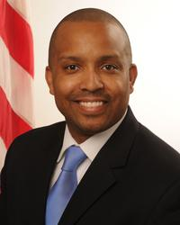
Keynote: Adjustments by the Federal Government for Meaningful Use of Artificial Intelligence – Tom Mason, MD.
Chief Medical Officer, Office National Coordinator, Health Information Technology, Department Health and Human Services

Slide 8
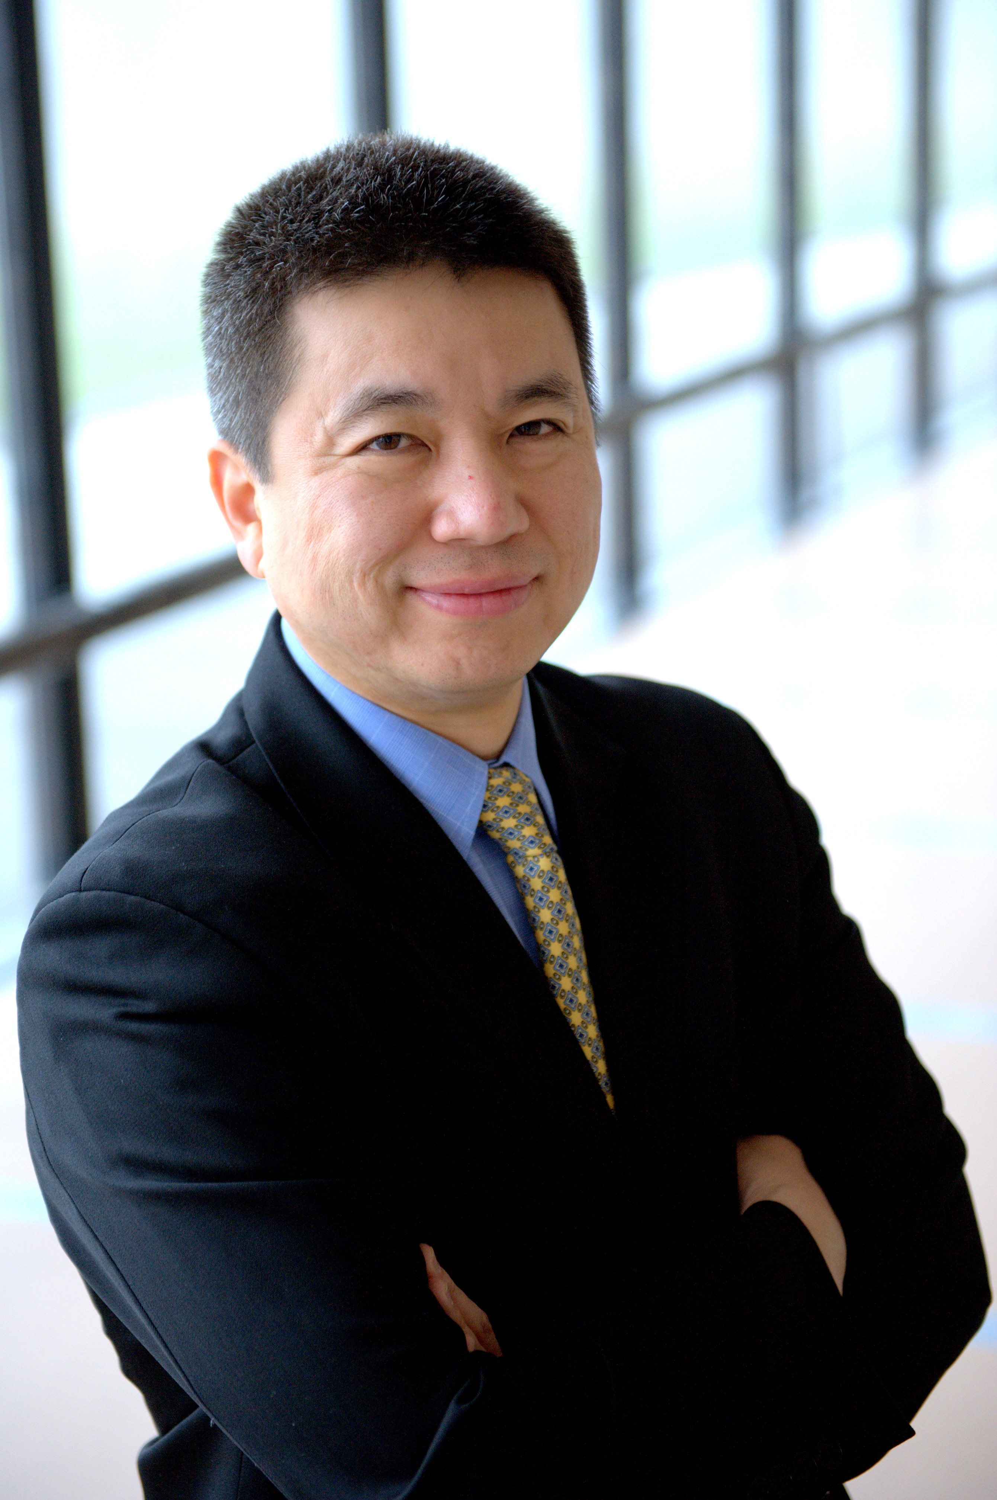
Keynote: Lessons Learned from an Early Mover – Kyu Rhee, MD
Vice President and Chief Health Officer
IBM Corporation

Slide 9
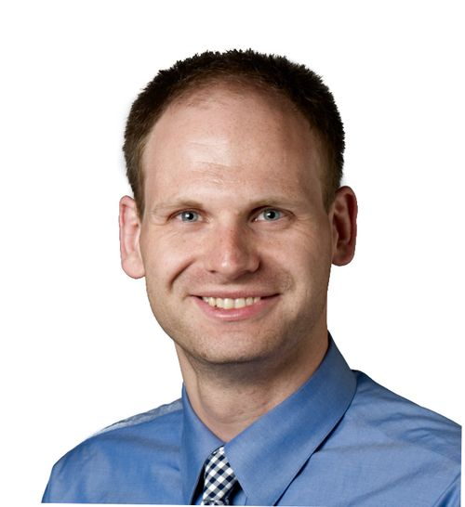
Keynote: A View From the Clouds – Michael Muelly, MD
Head of Strategic Products – Google Healthcare

